Slide 1



Fuel Effects On Regulated And Unregulated Emissions From Three Light-Duty Euro 5 And Euro 6 Diesel Passenger Cars
Rod Williams, Shell Global Solutions (UK), Concawe (Presenter)
Roland Dauphin, Concawe
Jon Andersson, Ricardo UK Ltd, Automotive and Industrial
Pauline Ziman, PHS Consulting Ltd
John Rogerson, INCIBI LTD
Heather Hamje, Concawe

Slide 2
Contents
Fuel effects on regulated and unregulated emissions from three light-duty Euro 5 and Euro 6 diesel passenger cars
        Background
        Objectives & Scope
        Experiment
        Results – Tailpipe
        Results – Comparison of Engine-out & Tailpipe, Euro 6d-TEMP Car
        Conclusions

Slide 3
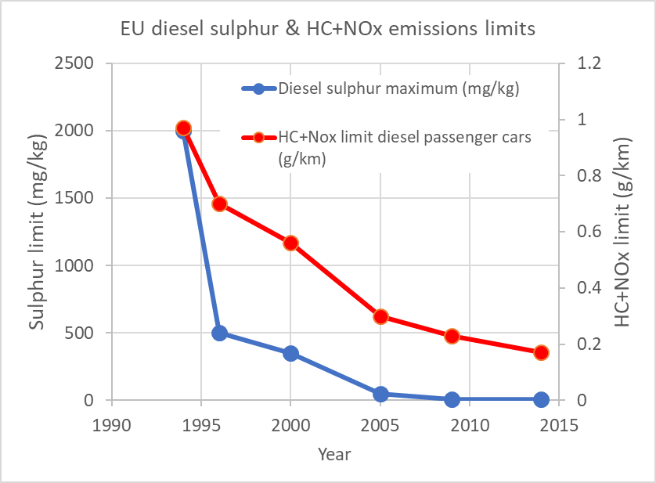
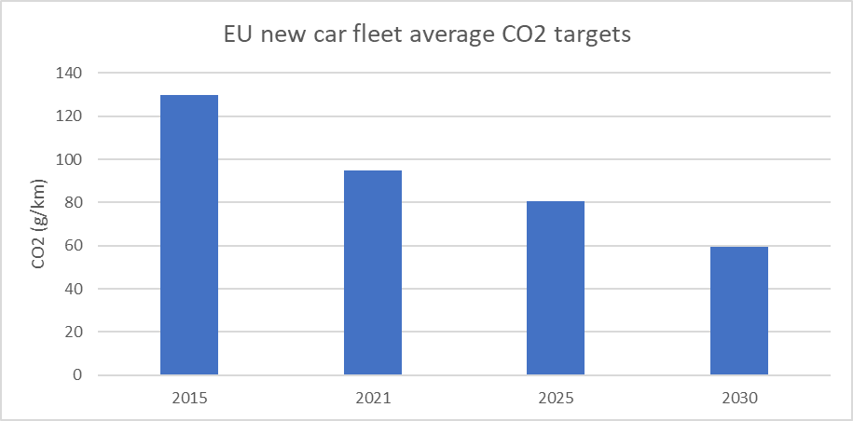
Background
        European automotive vehicles and fuels advanced in parallel to attain current Euro 6 levels of emissions and efficiency.
        Further advances in pollutant emissions control will be achieved in the next decade with Euro 7.
        Meanwhile the emphasis is changing to reducing the global warming impact of vehicles, which will drive both vehicle efficiency and a shift to more renewable fuels and electrification.

Slide 4
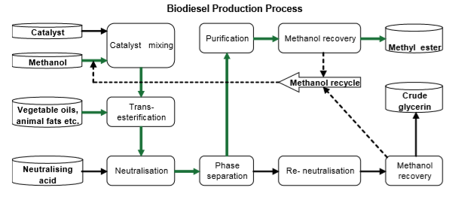
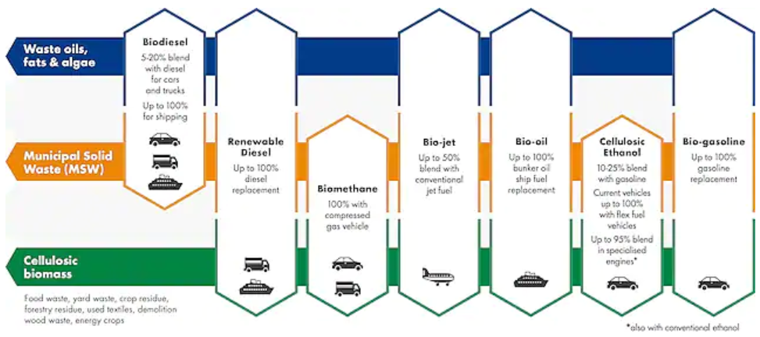
Background
      FAME is the most abundant renewable fuel suitable for current technology CI engines - permitted in EN590 up to 7%v, up to 30%v for captive fleets and in some non-European markets.
      FAME has potential to help further with the switch to renewables, but brings challenges including ILUC and vehicle compatibility.
      Renewable paraffinic diesel (HVO) faces some of the same ethical challenges around ILUC, but brings benefits in vehicle compatibility and pollutant emissions.
      A wide range of alternative renewable transport fuels are at various stages of research and development.

Slide 5
Contents
Fuel effects on regulated and unregulated emissions from three light-duty Euro 5 and Euro 6 Diesel passenger cars
        Background
        Objectives & Scope
        Experiment
        Results – Tailpipe
        Results – Comparison of Engine-out & Tailpipe, Euro 6d-TEMP Car
        Conclusions

Slide 6
Objectives & Scope
Objective
    Provide understanding of the benefits that diesel fuels operable in current automotive technology applications could offer to both emissions affecting local air quality and to greenhouse gas emissions.
Scope
    Focus on Tank-To-Wheels (TTW) Greenhouse Gas and pollutant emissions effects.
    Some fuels tested were not EN590-compliant. Vehicle compatibility considerations were outside the scope of this study.
    Tests over the WLTC rather than the RDE (Real Driving Emissions) protocol to obtain the experimental repeatability required to analyse fuel effects.
    Testing was limited to one example each of Euro 5, 6b and 6d-TEMP European passenger cars due to resource constraints.

Slide 7
Contents
Fuel effects on regulated and unregulated emissions from three light-duty Euro 5 and Euro 6 Diesel passenger cars
        Background
        Objectives & Scope
        Experiment
        Results – Tailpipe
        Results – Comparison of Engine-out & Tailpipe, Euro 6d-TEMP Car
        Conclusions

Slide 8
Experiment - Fuels
Low density fuel set
B30 fuel set
Fuel code / description | To evaluate impact of: | Density (kg/l) | Cetane number | C/H/O ratio (%m/m) | Total aro. (%m/m) | T95 (°C) | NHV (MJ/l)
F1: EN590 B5 – 5%v UCOME & 95%v conventional European diesel. | Comparator fuel representing current European diesel | 0.845 | 52.0 | 86.45/ 13.05/ 0.5 | 34 | 356 | 36.1
F2: LD B5 – 5%v UCOME & 95%v low density conventional refinery streams (jet + diesel) | Lower density/higher H/C ratio petroleum derived fuel | 0.805 | 51.4 | 85.33/ 14.12/ 0.55 | 7 | 351 | 34.8
F3: PDF – renewable paraffinic diesel fuel (HVO) | PDF representing various sources | 0.764 | 79.6 | 84.62/ 15.38/ | 0.1 | 289 | 33.8
F4: PDF50 – 50%v EN590 B5 and 50%v PDF | PDF quality as a blending component | 0.805 | 67.0 | 85.66/ 14.08/ 0.26 | 17.9 | 338 | 34.9
F5: B30 – 30%v UCOME and 70% low density conventional streams | Sustainable high FAME fuel | 0.825 | 52.4 | 83.59/ 13.12/ 3.29 | 5.1 | 348 | 34.4
F6: B30+CNI B30 + 0.52% 2-EHN cetane number improver | CNI to counter any NOx penalty | 0.826 | 65.8 | 83.6/ 13.12/ 3.27 | 4.5 | 350 | 34.4

Slide 9
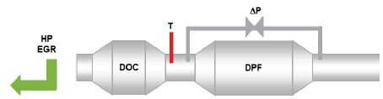
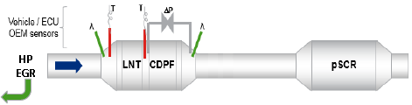
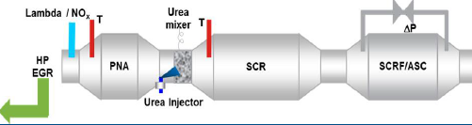
Experiment – Test Vehicles
    The test vehicles were chosen based on representation of:
    vehicle types common in the European market;
    engine and emission control technologies common in the European market;
    vehicles certified to Euro 5, Euro 6b and Euro 6d-TEMP;
    different parent OEMs;
    common car segment and engine sizes.
 | Car A | Car B | Car C
Emissions class | M1 | M1 | M1
Size category | C - SUV | C | C
Emissions cert. | Euro 5b | Euro 6b | Euro 6d-TEMP
Year of reg. | 2013 | 2016 | 2017
Swept volume (l) | 1.6 | 1.5 | 1.5
Exhaust after-treatment | HP EGR, DOC, DPF | HP EGR, LNT, DPF, passive SCR | HP EGR, PNA, urea-SCR, SCRF
Trans. | DCT6 | M6 | M6
SOT mileage (km) | 91,000 | 10,000 | 6,000
Mass in running order (kg) | 1365 | 1420 | 1355
Car A
Car B
Car C

Slide 10
Experiment - Testing
    Tests were carried out over the WLTC.
    Road load models were derived from track-based coast-downs.
    Test order was designed to avoid back to back repeats on the same fuel.
    Between tests, fuel was flushed and a full WLTC driven as pre-conditioning.
    Vehicles were soaked and tested at test cell air temperature of 23degC.
    Tests affected by DPF regenerations were repeated to maximize potential to detect fuel-fuel differences.

Slide 11
Experiment - Measurements
    Physical and OBD parameters were monitored to ensure consistency between tests, including critically EGR activity.
    Regulated and non-regulated emissions were measured.
    Engine-out emissions were compared to tailpipe values in the Euro 6d-TEMP car.
Measuring system | Metrics
Chassis dynamometer control computer | Speed, load, test cell air temperature, EGR valve voltage (Euro 5 car only)
Horiba OBS-ONE (dilute gas systems) | Dilute bagged and continuous tailpipe NO_{x}, NO, CO₂, CO, HC, CH₄, gravimetric PM
DiagRA | OBD (On-Board Diagnostics) parameters
Quantum Cascade Laser (QCL) | NH₃, N₂O (Nitrous Oxide) (tailpipe)
Cambustion Differential Mobility Particle Sizer DMS500 | Particle size distribution (tailpipe)
SPCS (Solid Particle Counting System) PMP method | PN > 23nm d50 (median particle size) (tailpipe)
Particle number down to ten (DTT) system | PN > 4nm d50, PN > 10nm d50, PN >23nm d50 (tailpipe)
Horiba OBS-ONE (raw gas systems) | Euro 6d-TEMP car only: Engine out HC, CO, CO₂, NO_{x}
Engine-out emissions tapping

Slide 12
Contents
Fuel effects on regulated and unregulated emissions from three light-duty Euro 5 and Euro 6 Diesel passenger cars
        Background
        Objectives & Scope
        Experiment
        Results – Tailpipe
        Results – Comparison of Engine-out & Tailpipe, Euro 6d-TEMP Car
        Conclusions

Slide 13
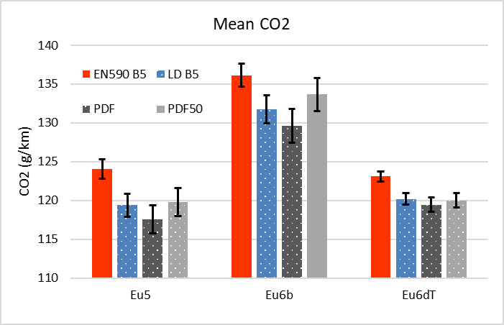
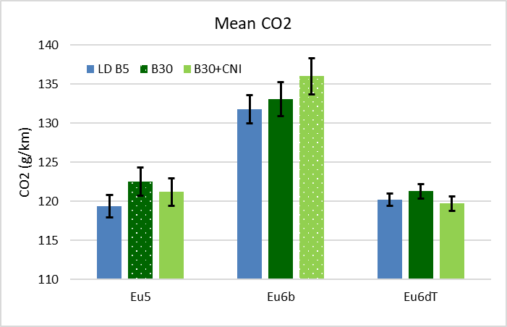
Results – Key & CO₂
Fuels with lower density and higher H/C ratio tend to give lower CO₂ emissions than the EN590 B5.
    Fuel comparisons follow logic based on blend similarity, as follows: -
    EN590 B5 vs LD B5, PDF and PDF50
    LD B5 vs B30 and B30 + CNI
    Error bars denote the 95% confidence intervals about the mean.
    Differences between fuel means that are statistically significant at the 95% confidence level from the comparator fuel are marked with patterned bars.
Impact of B30(+CNI) varies between vehicle.
Notes:
It is possible that the high cetane number resulting from the addition of the CNI could over-advance start of combustion leading to lower thermal efficiency for vehicles calibrated to have optimal combustion phasing with fuels of cetane numbers typical in the European market, (around 51-55). This is dependent on the calibration of the individual vehicle type and could explain why CO₂ (Figure 3) and volumetric fuel consumption (Figure 5) is higher with B30+CNI in only one of the three test vehicles. Higher CO2 with B30 in the Euro 5 car could be due to de-optimization of fuel metering with the high oxygen-content fuel which would require higher injected fuel volumes compared to B5 fuel.

Slide 14
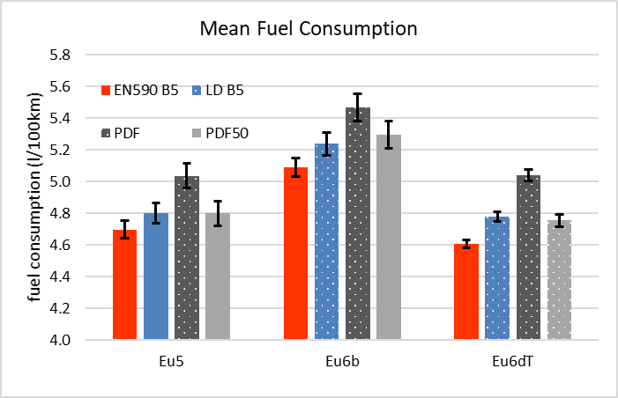
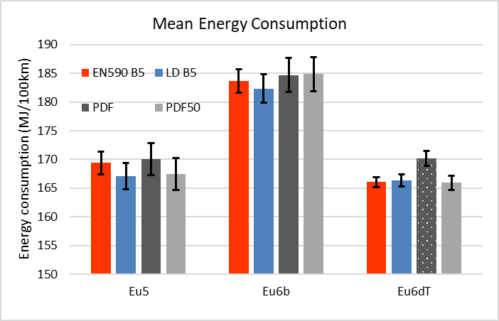
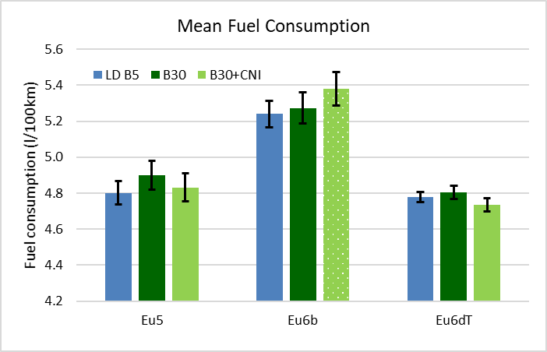
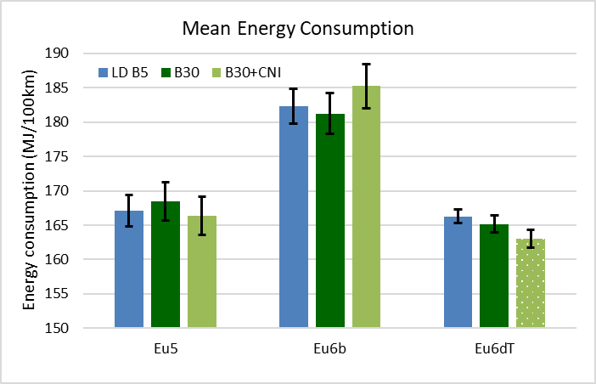
Results – Volumetric Fuel & Energy Consumption
Fuels with lower density and higher H/C ratio tend to give higher volumetric fuel consumption but similar energy consumption
Fuel and energy consumption unaffected by B30, but effects of B30+CNI in 2 cars could be calibration-specific sensitivity to combustion advance with high CN fuel
Notes:
Volumetric fuel consumption calculated from the carbon balance of emissions, the fuel H/C, O/C (Oxygen/Carbon) ratios, energy content and density, was dominated by fuel volumetric energy density and was therefore higher for the low density fuels than the comparator EN590 B5 fuel.
There was only one significant fuel effect on energy consumption for the low density fuels compared to the EN590 B5, which was in the Euro 6d-TEMP car with PDF which was significantly higher, Figure 6. It is postulated that this may be due to the vehicle responding to the longer injection duration required with low density fuel which has resulted in a different, less energy efficient operating region on the engine map being applied.
It is possible that the high cetane number resulting from the addition of the CNI could over-advance start of combustion leading to lower thermal efficiency for vehicles calibrated to have optimal combustion phasing with fuels of cetane numbers typical in the European market, (around 51-55). This is dependent on the calibration of the individual vehicle type and could explain why CO₂ (Figure 3) and volumetric fuel consumption (Figure 5) is higher with B30+CNI in only one of the three test vehicles.

Slide 15
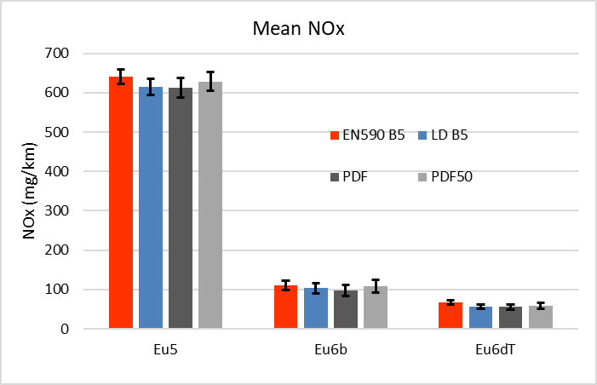
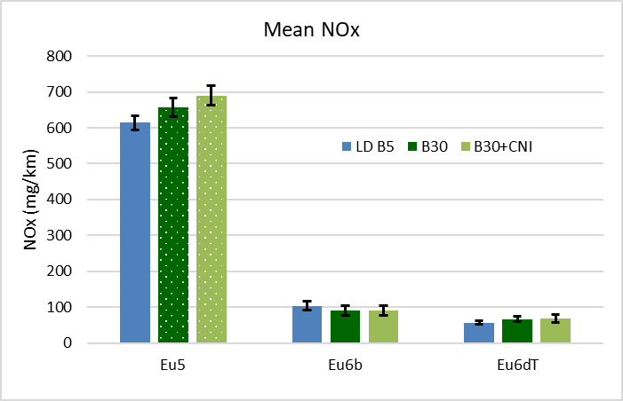
Results – Oxides of Nitrogen
NO_{x} was directionally lower (non-significant) for all low-density fuels in all cars compared to the EN590 B5 and PDF gave a statistically significant benefit for NO_{x} on a fleet average basis.
    WLTC NO_{x} was substantially higher than the 180mg/km Euro 5 limit from the (NEDC-certified) Euro 5 car.
    WLTC NO_{x} from the Euro 6b car (NEDC certified) was close to the Euro 6 limit (80mg/km).
    NO_{x} from the Euro 6d-TEMP car over the WLTC was under the Euro 6 limit in all cases.
    There were no significant differences in the fraction of NO₂ contained in the NO_{x} emissions between any of the fuels.
NO_{x} was significantly higher with B30 fuel and with B30 + CNI than with LD B5 in the Euro 5 car.
The addition of CNI to B30 did not reduce the NO_{x} values in any car.
Notes:
NO_{x} was directionally lower for all low-density fuels in all cars compared to the EN590 B5, however none of the individual results were statistically significant at the 95% confidence limit, although LD B5 and PDF were significantly lower than the EN590 B5 at the 90% confidence level.
NO_{x} was significantly higher with B30 fuel and with B30 + CNI than with LD B5 in the Euro 5 car which emitted high absolute NO_{x} levels and is not fitted with catalytic NOx exhaust aftertreatment. NO_{x} differences were not significant between the LD B5 and B30 fuels in the Euro 6 cars. The addition of CNI to B30 did not reduce the NO_{x} values in any car, Figure 9. Traditionally, the addition of CNI may have been expected to reduce the NOx increase sometimes observed with the use of high FAME fuel concentrations. The explanation why this is not observed here may be twofold. Firstly there is the direct nitrogen contribution of the CNI which could contribute to NOx and secondly, modern diesel vehicles systematically employ multiple injection strategies to control the auto-ignition delay with pilot injections and may be less sensitive to CN for the control of the premixed flame; hence less sensitive to CNI for NOx emissions reduction.

Slide 16
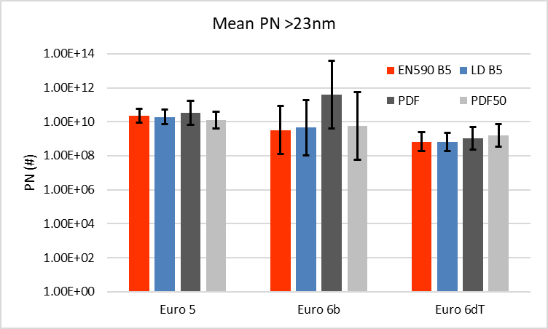
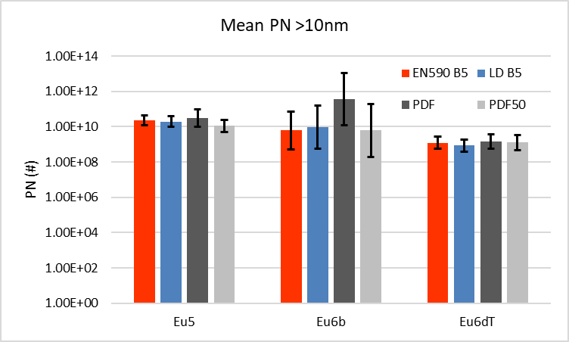
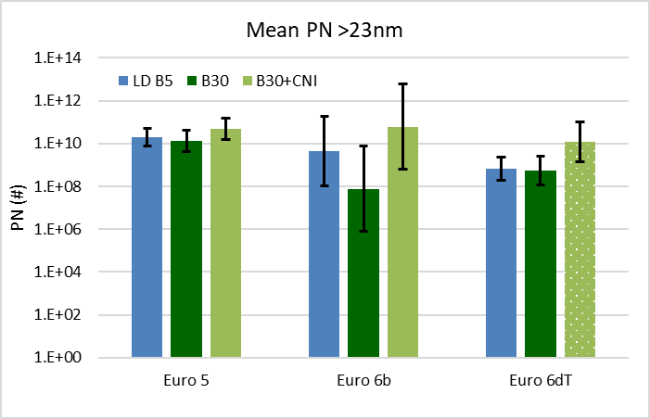
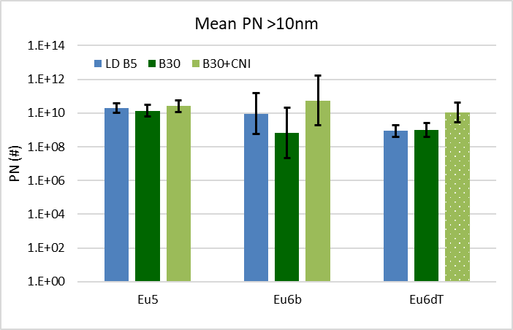
Results – Particulate Mass and Number
    Mean particulate mass was less than 0.4mg/km for all fuels and there were no significant fuel effects.
    PN means for all fuels, cars, measurement methods and particle size classes were below the 6 x 10¹¹ Euro 6 PN limit.
Three were no significant fuel effects on PN in the low density fuel set
The B30+CNI fuel produced higher PN than the LD B5 fuel in the Euro 6d-TEMP car in all size ranges and measurement methodologies.
Notes:
The B30 + CNI fuel produced higher PN than the comparator LD B5 fuel in the Euro 6d-TEMP car in all size ranges and both measurement methodologies, however this was based on a single valid test with the B30 + CNI fuel, Figures 12-13. The difference between LD B5 and B30 + CNI was smaller in the >10nm range than in the >23nm range, therefore the extended PN measuring size range would not lead to a worsening effect on PN of this fuel

Slide 17
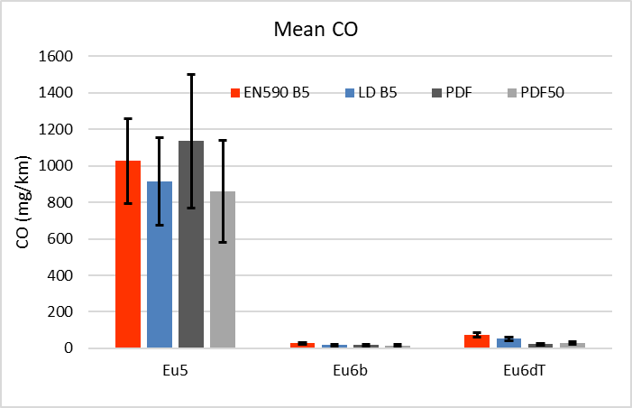
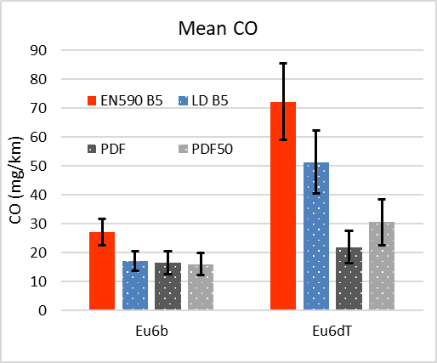
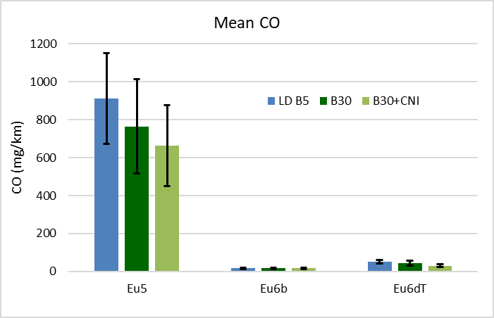
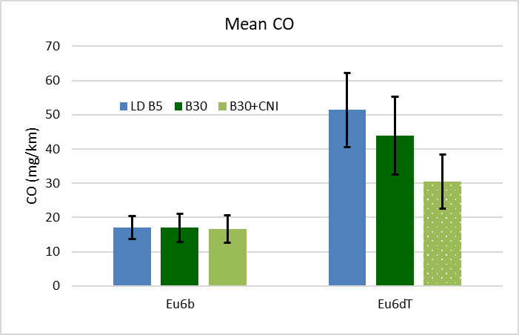
Results – Carbon Monoxide
CO was significantly lower for LD B5, PDF and PDF50 than for EN590 B5 in both Euro 6 cars; there were no significant fuel differences in the Euro 5 car
    CO over the WLTC was much higher than the Euro 5/6 limit in the Euro 5 car in all cases.
    CO was well below the Euro 6 limit for the Euro 6 cars.
CO was lower for the B30 and B30 + CNI fuels in the Euro 5 and Euro 6d-TEMP cars, but the difference was only statistically significant in the Euro 6d-TEMP car with B30 + CNI.
Notes:
CO over the WLTC was much higher than the Euro 5/6 limit in the Euro 5 car in all cases and it is postulated that this is due to low catalyst volume, or precious metal loading to deal with the CO instead of a difference due to the use of the WLTC instead of the NEDC over which the car would have been certified. CO was around an order of magnitude below the Euro 5/6 limit from the Euro 6b and Euro 6d-TEMP cars.
Note that benefits for PDF50 are >50% of those for PDF

Slide 18
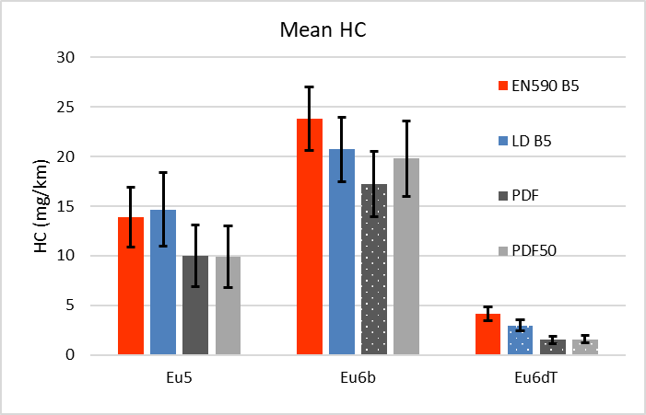
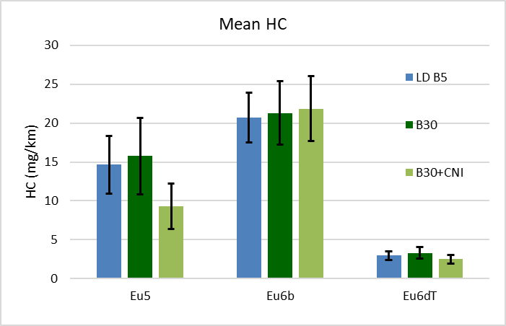
Results – Hydrocarbons
    Hydrocarbon emissions were very low for all fuels and cars.
HC was directionally lower for the low density fuels in most cases and significantly different in some.
There was no impact on HC with B30 or B30 + CNI compared to LD B5 that was consistent between vehicles or statistically significant
Notes:
Note that benefits for PDF50 are >50% of those for PDF

Slide 19
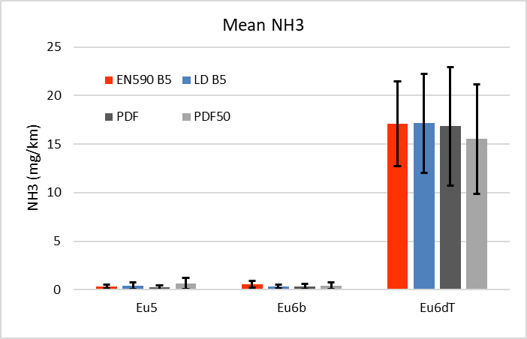
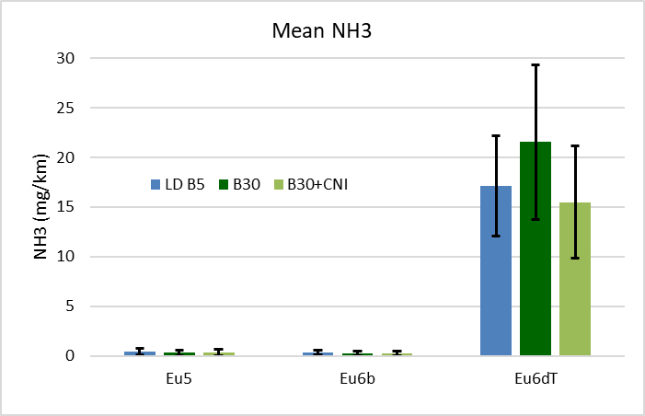
Results – Ammonia
    Ammonia emissions were very low in the Euro 5 and Euro 6b cars (<1 mg/km) which were not equipped with urea-SCR and considerably higher in the Euro 6d-TEMP car (with urea-SCR), despite the presence of an ASC.
    No fuel related differences were detected in either the low density or B30 fuel set

Slide 20
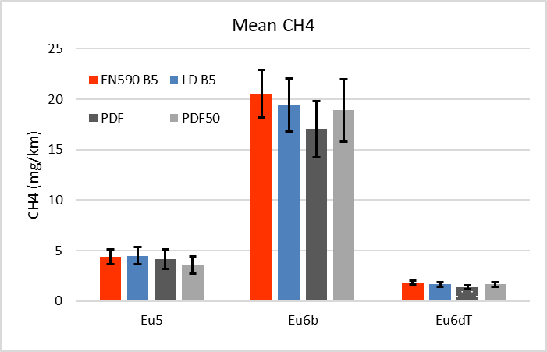
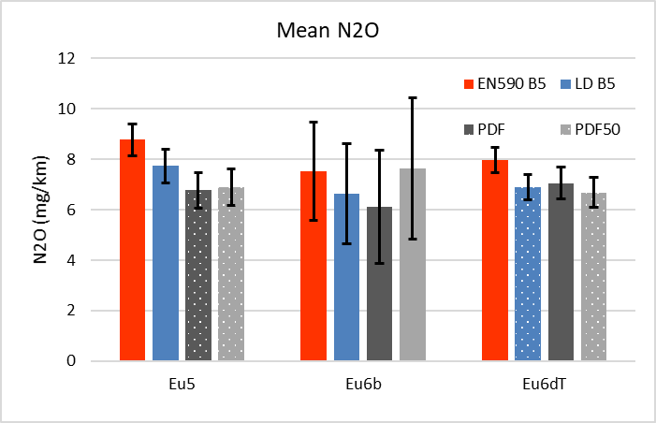
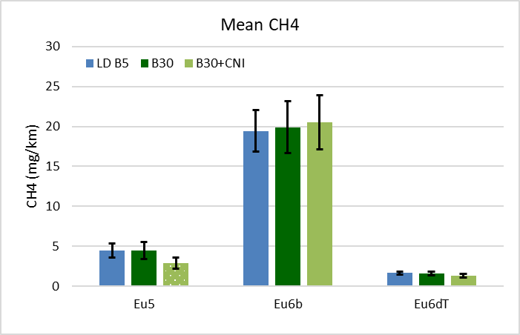
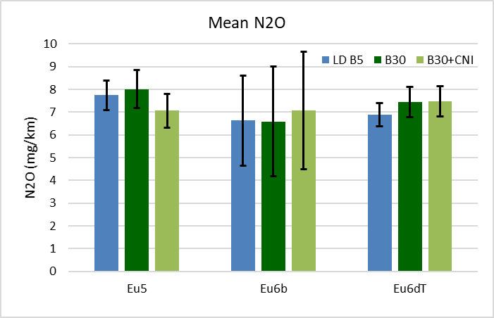
Results – Greenhouse Gases (1 of 2)
    CH₄ emission levels were vehicle dependent & highest in the Euro 6b car with lean NO_{x} trap.
    Unexpectedly, N₂O was not higher from the cars with catalytic de-NO_{x}.
    Possible that atmospheric N₂O contributed to tailpipe levels.
Low density fuels tend to reduce CH₄ - similar to observed effects on HC, but to a lesser extent
N₂O is generally lower for low density fuels, some differences are significant.
Trends in CH₄ with B30 & B30+CNI similar to HC, significant reduction in CH₄ for B30+CNI in the Euro 5 car
No differences in N₂O that were significant / consistent between vehicles in B30 fuel set.
Notes:
Note that benefits for PDF50 are >50% of those for PDF

Slide 21
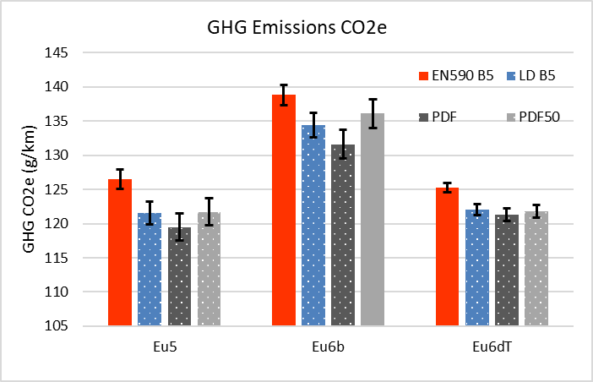
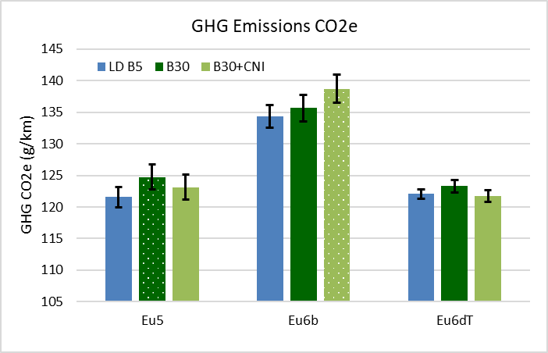
Results – Greenhouse Gases (2 of 2)
The results showed significantly lower GHG for LD B5, PDF & PDF50 except for PDF50 in the Euro 6b car which was significant at the 90% confidence limit. In 8 out of the 9 cases total GHG differences were larger than CO₂ differences (in the ninth case equal), due to benefits in both N₂O & CH₄.
    The emissions of CO₂, CH₄ & N₂O were added to determine total GHG emissions for each fuel and car combination in terms of global warming potential (GWP) 100 year figures for CO₂e (CO₂ equivalent) using the GREET model.
    The GWP of the CH₄ emissions measured in terms of CO₂ equivalent (CO₂e) lie between 0.06 – 0.6g/km.
    The GWP of the N₂O emissions measured in terms of CO₂e lie between 1.6 – 2.3g/km.
GHG emissions on a CO₂e basis showed little difference from the CO₂ results within the B30 fuel set.
Notes:
Note that benefits for PDF50 are >50% of those for PDF

Slide 22
Contents
Fuel effects on regulated and unregulated emissions from three light-duty Euro 5 and Euro 6 Diesel passenger cars
        Background
        Objectives & Scope
        Experiment
        Results – Tailpipe
        Results – Comparison of Engine-out & Tailpipe, Euro 6d-TEMP Car
        Conclusions

Slide 23
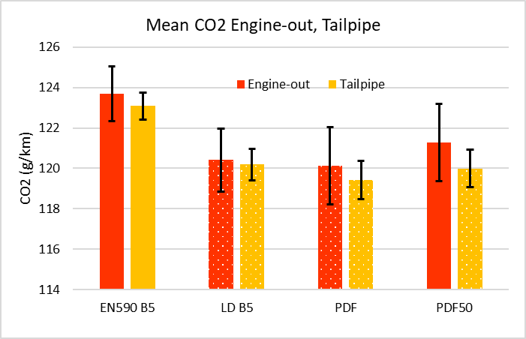
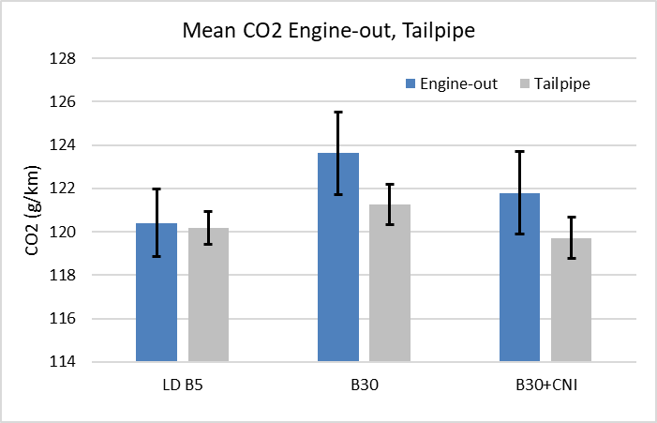
Results – EO & TP Euro 6d-TEMP – CO₂
    Differences in accuracy is postulated as being the reason for the consistently lower tailpipe CO₂ levels versus engine-out.
    The expectation would be that CO₂ would be very similar, or slightly higher in the tailpipe sample due to the oxidation of carbon-containing species (CO, HC, PM) in the exhaust oxidizing catalysts.
    Trends in engine-out CO₂ were similar to those of tailpipe CO₂, though engine-out results are more variable.
Notes:
Note that benefits for PDF50 are >50% of those for PDF

Slide 24
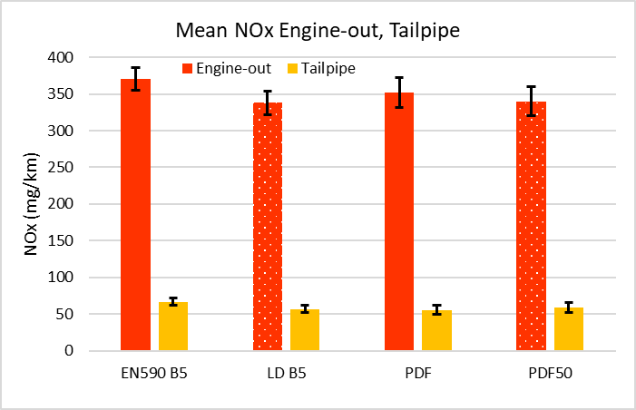
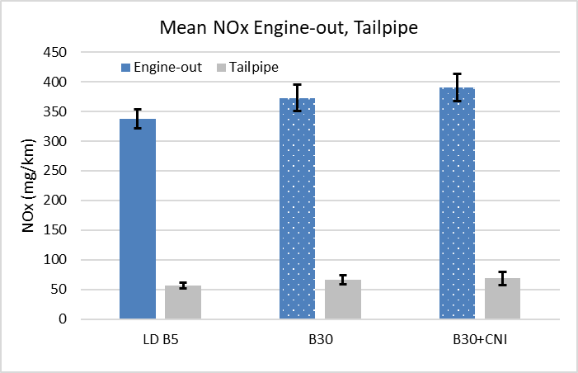
Results – EO & TP Euro 6d-TEMP – NO_{x}
    Engine-out NO_{x} is substantially reduced across the exhaust aftertreatment system.
    Engine-out emissions from the low-cycle of the WLTC including the cold start are similar to those from the whole WLTC, though tailpipe emissions are substantially higher due to aftertreatment efficiency related to temperature.
    Fuel effects are similar between the low sub-cycle and whole WLTC.
Engine-out NO_{x} tends to be lower from the low density fuel – therefore lower conversion efforts from the AT system.
Engine-out NO_{x} from B30 and B30 + CNI is significantly higher than from LD B5, however these differences are not significant in the tailpipe emissions
Notes:
Engine-out NO_{x} is substantially reduced across the exhaust aftertreatment system and there are statistically significant benefits in engine-out NO_{x} for LD B5 and PDF50 versus EN590 B5, requiring less conversion efforts from the aftertreatment system, Figure 28. It is somewhat surprising that larger engine out NOx benefits are not observed for the PDF, presuming that the lack of aromatics in the fuel is the reason for the NOx benefit in the PDF50 fuel relative to the EN590 B5. Engine-out emissions from the low sub-cycle of the WLTC including the cold start are similar to those from the whole WLTC.
Engine-out NOx from B30 and B30 + CNI is significantly higher than from LD B5, however these differences are not significant in the tailpipe emissions, meaning that these fuels may require more conversion from the aftertreatment system, which is actually achieved
Note that benefits for PDF50 are >50% of those for PDF

Slide 25
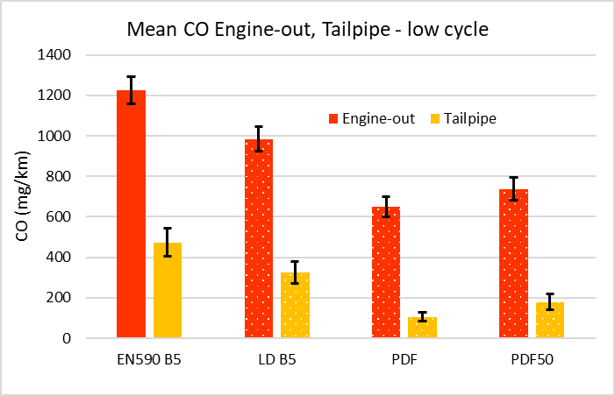
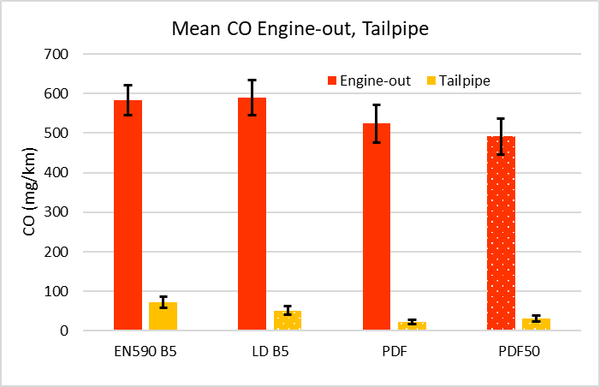
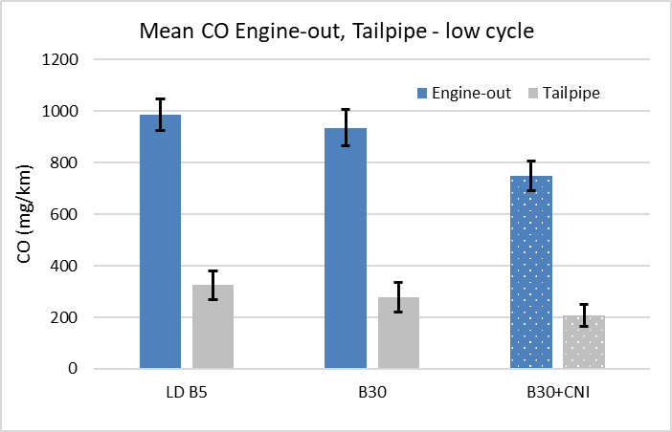
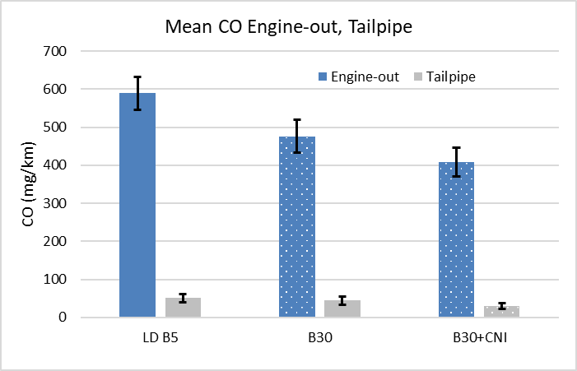
Results – EO & TP Euro 6d-TEMP – CO
Low density fuels reduce EO CO except apparently LD B5 – this could be an artefact of the measurement – given that a benefit in TP CO is observed.
Benefits are proportionally larger in the low-cycle results.
    Engine-out CO is substantially reduced across the exhaust aftertreatment system.
    CO from the low-cycle which includes cold start is higher than whole-cycle.
B30 tends to reduce EO CO, CNI increases the benefit. Benefits are proportionally larger in the whole-cycle results.
Notes:
Tailpipe CO levels are much lower than engine-out levels due to the oxidizing activity of the exhaust aftertreatment system. Reduction of engine-out CO is evident for the PDF and PDF50 fuels relative to the EN590 B5, however this is only significant in the PDF50 results due to the relatively high variability in the engine-out data. Furthermore, there is no benefit in engine-out CO evident for the LD B5 vs EN590 B5 despite there being a significant difference in the tailpipe data. This appears to indicate that a fuel benefit manifests within the aftertreatment system to enhance the oxidation of CO, however this could be an artefact of the variability of the engine-out measurement.
Engine out CO was much higher from the low sub-cycle, which includes the cold start emissions, than the whole WLTC. Tailpipe emissions were also much higher due to part of this period being before the oxidation catalyst light-off temperature being reached. Fuel effects were larger in both engi.ne-out and tailpipe CO emissions for this sub-cycle, being significantly lower for LD B5, PDF and PDF50 than for EN590 B5.
Fuel effects on HC of low density/aro appear to be larger in cold start, whereas fuel effects of oxygen appear to be larger in normal operating temperatures
Note that benefits for PDF50 are >50% of those for PDF

Slide 26
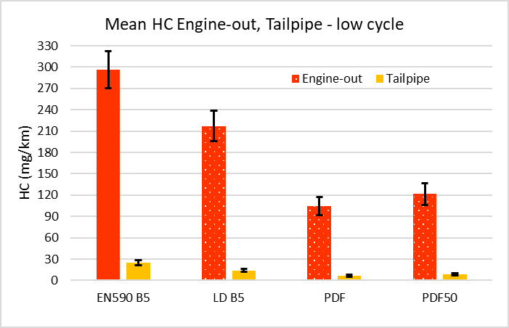
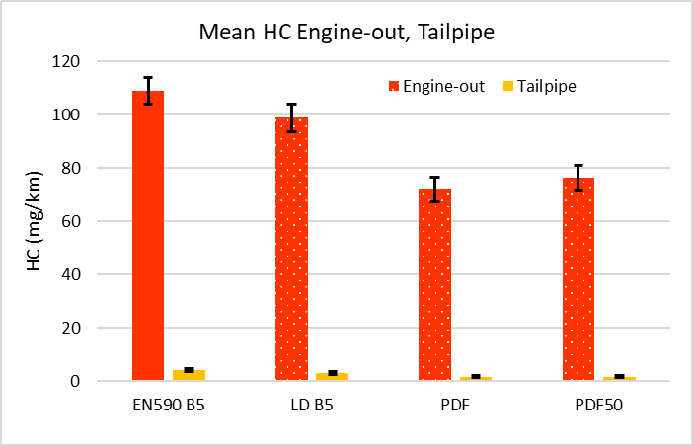
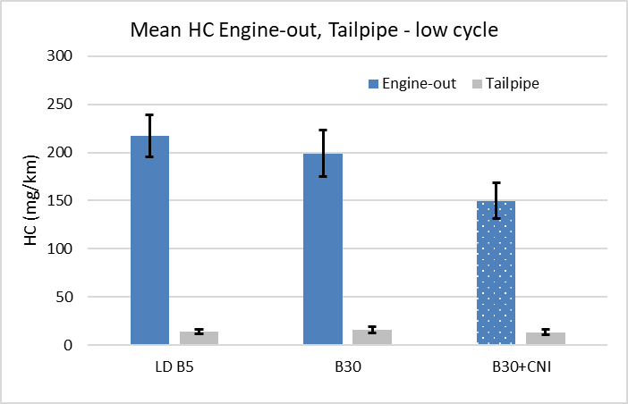
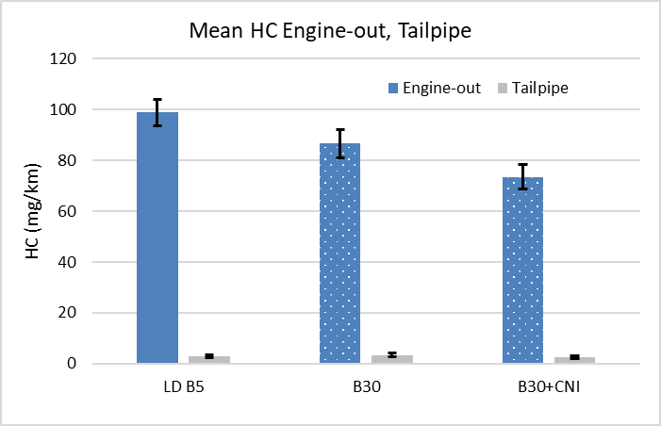
Results – EO & TP Euro 6d-TEMP – HC
    HC levels are substantially reduced across the AT.
    Engine out HC was much higher from the low sub-cycle, which includes the cold start emissions.
Low density fuels reduce EO HC, benefits are proportionally larger in the low-cycle results.
B30 tends to reduce EO HC, CNI increases the benefit. Benefits are proportionally larger in the whole-cycle results.
Notes:
Tailpipe HC levels are much lower than engine-out levels due to the oxidation activity of the exhaust catalysts. Reduction of engine-out HC is evident for the LD B5, PDF and PDF50 fuels relative to the EN590 B5, differences which are all statistically significant (as is the case for the tailpipe data),
Engine out HC was much higher from the low sub-cycle, which includes the cold start emissions, than from the whole WLTC. Tailpipe emissions were also much higher due to part of this period being before the oxidation catalyst light-off temperature being reached. Fuel effects were larger in both engine-out and tailpipe HC emissions for this sub-cycle, being significantly lower for LD B5, PDF and PDF50 than for EN590 B5
Over the whole WLTC, B30 and B30 + CNI both produced significantly lower engine-out HC than LD B5, whereas these differences were not significant in the much lower tailpipe data, Figure 36. In the WLTC low sub-cycle data only the B30 + CNI gives a significant reduction in HC versus LD B5 which is only observed in the engine-out data
Fuel effects on HC of low density/aro appear to be larger in cold start, whereas fuel effects of oxygen appear to be larger in normal operating temperatures
Note that benefits for PDF50 are >50% of those for PDF

Slide 27
Contents
Fuel effects on regulated and unregulated emissions from three light-duty Euro 5 and Euro 6 Diesel passenger cars
        Background
        Objectives & Scope
        Experiment
        Results – Tailpipe
        Results – Comparison of Engine-out & Tailpipe, Euro 6d-TEMP Car
        Conclusions

Slide 28
Conclusions
    From WLTC tests of six ‘drop-in’ diesel fuels in single Euro 5, Euro 6b and Euro 6d-TEMP cars it can be concluded that: -
    Low-density hydrocarbon fuels can offer benefits in TTW CO₂, other GHG emissions and emissions impacting local air quality, conversely some traditional benefits of fuel quality on emissions are reduced or even deleted in the tailpipe emissions of cars using advanced exhaust aftertreatment (AT).
    Paraffinic diesel fuel as a blend component can give disproportionally large emission benefits, boding well where PDFs are in short supply and for the future when BTL and PTL fuels become more widely available.
    Advanced AT suppresses the negative NO_{x} effects associated with the use of high FAME fuels, opening the door to the use of such fuels in markets dominated by advanced vehicles, therefore enabling increased use of such renewables without local air quality drawbacks.
    In the European cars tested, high levels of CNI did not mitigate the NO_{x} penalty traditionally associated with the use of high FAME content fuels.
    Deleterious fuel effects were not evident in the emissions slated for future regulation (<23nm PN, NH₃) however, some additional benefits may be achieved from application of specific fuel qualities (CH₄, N₂O).
    Most of the fuels tested constitute options to increase renewable fuel use, as well as the TTW effects studied, but additional OEM certification would be required to deploy them generally in the European market.

Slide 29
Acknowledgements
Members of Concawe STF/25 diesel fuel & emissions group
Ricardo UK, Automotive and Industrial
Coryton Specialty Fuels, UK

Slide 30
Thank you
      Rod Williams
      Shell Global Solutions (UK) / Concawe
      Rod.Williams@shell.com
      Roland Dauphin
      Concawe
      roland.dauphin@concawe.eu

