Slide 1

Future Diesel-like renewable fuels – A literature review
CEN/TC 19/WG 24 meeting – 26th April 2023
Roland Dauphin – Science Executive Fuels Quality & emissions
Mickaël Matrat - IFPEN

Slide 2
Contents
  Context & objective
  Identification/Selection of relevant pathways
    LCA and TEA
    Production potential
  Evaluation of blending behaviour
  Blending opportunities
  Summary and conclusion
Reference box for additional comments

Slide 3
Motivation
  Commercial HDV transportation is primarily powered by internal combustion engines (ICE)
  Although electrification is proposed, long-distance transport will still significantly rely on ICE in the next 10 years
    To decarbonize these vehicles, the development and use of low-carbon fuels by 2030 is essential
  Goal: identify the relevant renewable diesel-like options for 2030 by considering the following aspects
  ➔ Sustainability and scalability by 2030
    Consider feedstock type and availability, production cost, process maturity and life-cycle greenhouse gas emissions as key parameters
  ➔ Compatibility with legacy and future fleet
    Consider combustion, after-treatment efficiency, hardware compatibility and durability as key parameters
    Limited to no modifications to the vehicles’ settings and hardware
  ➔ Fuel specifications adaptation?
    Need to adapt fuel specifications to allow higher blending ratio of renewable fuels in the conventional diesel ‘EN590’ pool and go beyond the blending wall?

Slide 4

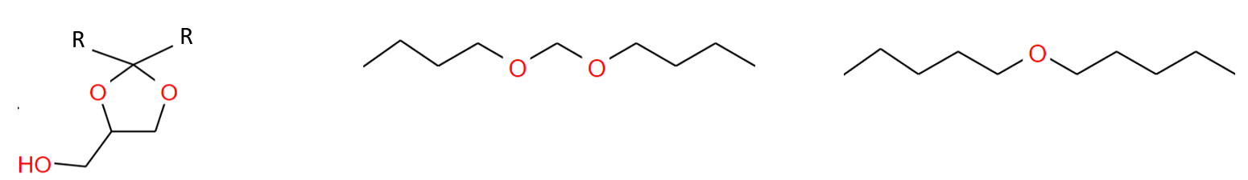
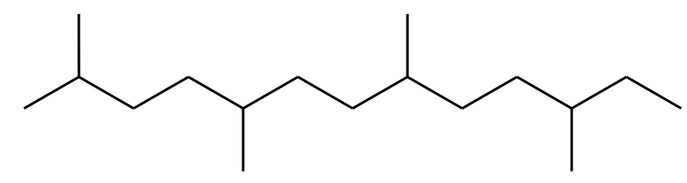
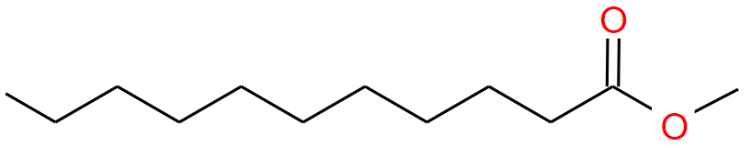
Structure of the study
Focus of this presentation
Task 1.
Task 2. Combustion system compatibility
Task 3.
Task 4.
LCA & Eco assessment of selected novel components
LCA & Eco assessment of selected energy paths toward FAME and paraffins
Blending optimisation with conv. fuels
Blending optimisation with conv. fuels
Task 5. Stakeholders Interviews
Task 6. Research needs & Conclusions

Slide 5
Selected pathways – Feedstock, process and product
Resource | Process | Product | Comments / Research needs
Lignocellulose | Fermentation ATD | Paraffinic distillate | Industrialised technology Flexibility to other products ➔ diesel or kerosene optimisation impacts?
Lignocellulose | Gasification - FT | Paraffinic distillate | Technology close to industrialization - Optimisation prospects Flexibility to other products but integrability and adaptation to lignocellulose required
WCO / Animal fat / Energy crop oil | Hydrotreatment of triglycerides | Paraffinic distillate (HVO / HEFA) | Industrialised technology Application to a wider range of resources Integration of renewable H2?
WCO / Animal fat / Energy crop oil | Transesterification | FAME | Industrialised technology – adapted to small scale /close to resource Blending constrains
Lignocellulose | eFuel – Lignoc. | Paraffinic distillate | eH2 and RWGS technology to industrialise Optimisation prospects (electrolysers, CO2 capture, CO/CO2 from biomass) High flexibility to other fuels
CO2 | eFuel – CO2 | Paraffinic distillate
E-fuel
Focus on hybrid process

Slide 6
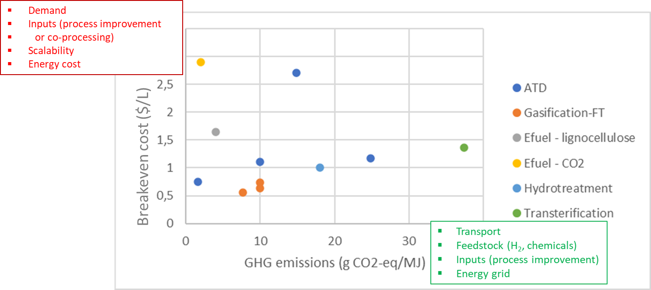
LCA – TEA of selected pathways
Best case
The sensitivity to the resource can be very different for the energy pathways (ATD)
Best CO₂ score for ATD and E-fuel
Good compromise for distillate from gasification + FT pathway

Slide 7
Biomass conversion yields to renewable fuels
Pathway | Feedstock | Mass yield
Fermentation – AtD | Sugarcane | 9 ↔ 12%
Oil hydrotreatment | Waste cooking oils | 90 %
 | Lard and beef tallow animal fats | 92 ↔ 97%
Transesterifcation | Waste cooking oils | 83 ↔ 97%
 | Animal fats | 93 %
Gasification + Fisher-Tropsch | Biomass | 14 ↔ 26%
E-fuel from lignocellulose | Biomass + electricity | 47 ↔ 52%
Lignocellulose hydrotreatment | - | No data found
E-fuel from CO₂ | - | No data found
Hypothesis : Full conversion of FT-wax into distillate

Slide 8


Potential middle distillate production
Based on biomass availability by 2030
Projected renewable fuel production assuming all the sustainable biomass* for bioenergy by 2030
Pathway | Fuel | Feedstock | Projected feedstock (Mt) | Estimated advanced renew. fuel quantity (Mt) | Estimated advanced renew. fuel quantity (Mt)
 |  |  | Imp. Coll. data | Imp. Coll. data | Literature review
Fermentation – AtD | Paraffinic fuel | Solid industrial waste (secondary agro & forest industries) | 133 → 191 | - | 14.6 → 21.0
 |  | Agricultural residues (straw-like) | 137 → 165 | - | 15.1 → 18.2
 |  | Lignocellulosic crops (grassy) | 36 → 108 | - | 4.0 → 11.9
Oil hydrotreatment | HVO | Used Cooking Oil (UCO) | 3.1 | 2.6 | 2.8
 |  | Animal fats | 2.2 | 1.87 | 2.1
Transesterification | FAME | Used Cooking Oil (UCO) | 3.1 | - | 2.8
 |  | Animal fats | 2.2 | - | 2.0
Gasification + Fisher-Tropsch | Paraffinic fuel | Solid industrial waste (secondary agro & forest industries) | 133 → 191 | 27.9 → 40.1 | 26.6 → 38.2
 |  | Agricultural (woody) & forestry residues | 5 → 7 | 1.0 → 1.5 | 1.0 → 1.4
 |  | Lignocellulosic crops (woody) | 36 → 108 | 7.6 → 22.7 | 7.2 → 21.6
E-fuel from lignocellulose | Paraffinic fuel | Solid industrial waste (secondary agro & forest industries) | 133 →191 | 53.2 → 76.4** | 66.5 → 95.5
 |  | Agricultural (woody) & forestry residues | 5 → 7 | 2 → 2.8** | 2.5 → 3.5
 |  | Lignocellulosic crops (woody) | 36 → 108 | 14.4 → 43.2** | 18 → 54
New
Conservative approach with most mature techonolgies
New
Assuming availabitily of renew. electricity
*Sustainable biomass availability in the EU, to 2050 – Imperial College London
**ICL report estimated advanced renew. fuel quantity as for 2050

Slide 9
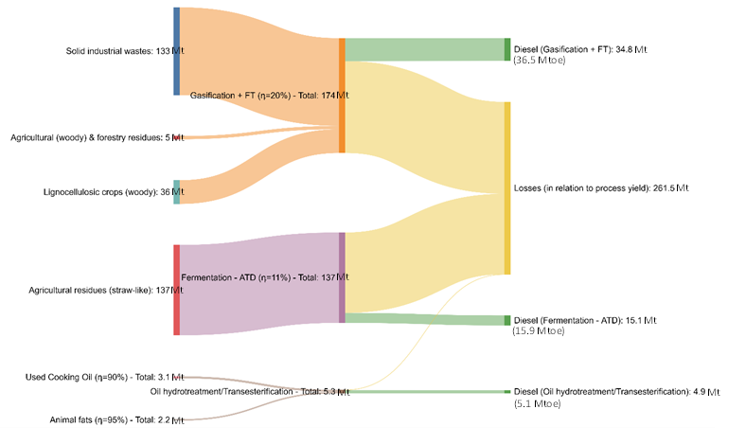
Renewable middle distillates production potential by 2030
Considering high TRL processes only, the renewable diesel production potential considering sustainable biomass availability by 2030 ranges between 57 and 88 Mtoe/y (i.e. 24-37% of demand for middle distillates which is estimated at 241 Mtoe out of 350 Mtoe for the transport sector in 2030)

Slide 10
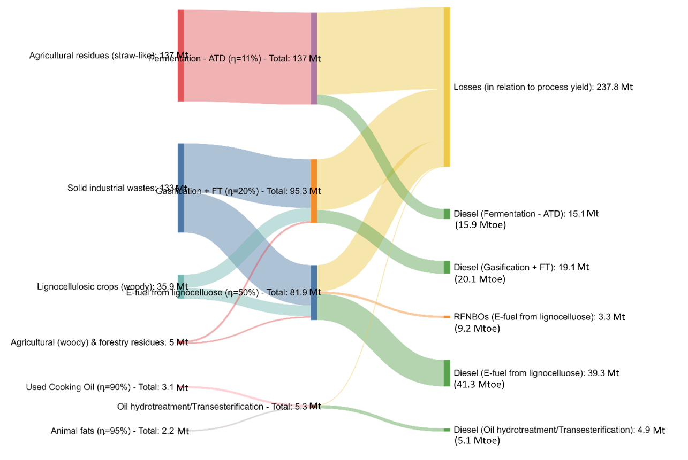
Renewable middle distillates production potential by 2030
Adding (former) regulatory objectives for RFNBOs (2.6% ener.), the renewable diesel production potential considering sustainable biomass availability by 2030 ranges between 92 and 123 Mtoe/y (i.e. 38-51% of demand for middle distillates in 2030)
Distillates production requirement in Mt (low resources mobilization and RFNBOs target)

Slide 11

Evaluation of blending behaviour & opportunities
Gasification - FT
eFuel – lignoc.
eFuel – CO2
Hydrotreatment Lignoc.
Hydrotreatment oil
Fermentation ATD
Transesterification
  Paraffins
  FT type of product
FT best and worst
HDT best and worst
Energy crops (EC)
Animal Fats (AF)
Waste cooking oil (WCO)
  Paraffins
  HDT type of product
  FAME
TRAN best and worst
Energy crops (EC)
Animal Fats (AF)
Waste cooking oil (WCO)
Characterisation of fuel variability
Definition of mixing rules (focus on cold flow properties but includes CN, FP, Density and Viscosity)
Blending optimisation with and without additives
Sensitivity from relaxed specifications

Slide 12
Blending limits - Conservative approach (MODEC model)
Base fuel CFPP: -25°C / Spec. Limit: -20°C (Class F)
CFPP
-20
14
2
2
-9
11
CFPP
-22
0
CFPP
20
-11
19
-44
21
Density and cold flow are the main constraints.
Not shown here but a different model would lead to 5-10 points increase once the CFPP is the limiting factor
Main advantage of extended specification is to be less density dependent for significant energy path (AF trans / HDT of energy crops / FT)
CFPP is the constraint otherwise and limits greatly the incorporation rate
FP can be a constraint for selected low-quality feedstocks (Worst HDT WCO/Trans AF)

Slide 13

Blending limits – Additive impact - Focus on EN590 boundaries
Base fuel CFPP: -25°C / Spec. Limit: -20°C (Class F)
CFPP
-20
14
2
2
-9
11
CFPP
-22
0
CFPP
20
-11
19
-44
21
With additives (Best case: boost -10°C)
With additive (Common case: boost -5°C)
Without additive
Additivation only improves cold flow properties (Cetane number is not a limit)
The use of cold flow improver increases the blending ratio from about 5 to 20 points. The increase being lower for higher CFPP temperatures. Nevertheless, the density can become a constraint before this maximum increase is reached (e.g. TRANS WCO or EC, FT, HDT WCO).
For every “best” energy path, the density is either the first constraint or it becomes quickly the limit if the cold flow improver additive is used.

Slide 14
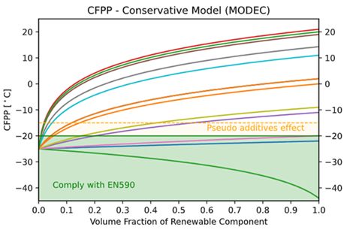
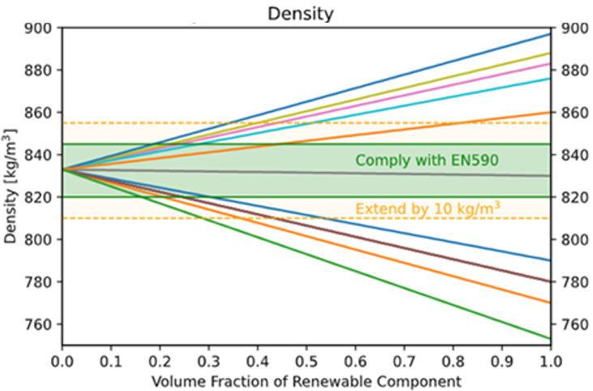
Insights into possible fuel specifications evolutions for an increased renewable content
  CFPP and Density are the main constraining properties
  Figures below illustrate CFPP and density blending behavior for all energy paths identified
Rapid CFPP increase at low blending ratio limiting the biocomponent concentration.
Adjusting the standards for CFPP may be difficult due to operating/logistic constraints.
Improving the cold flow properties of renewable diesel products through various means is potentially an important lever for maximizing the use of sustainable products.
Only one product identified is fully compatible with EN590 density range
Extending the EN590 density limits by ±10 kg/m3 (arbitrarily chosen for demonstration only) could lead to increase in the maximum blending ratio by about 15-25% (best case by 35%).

Slide 15

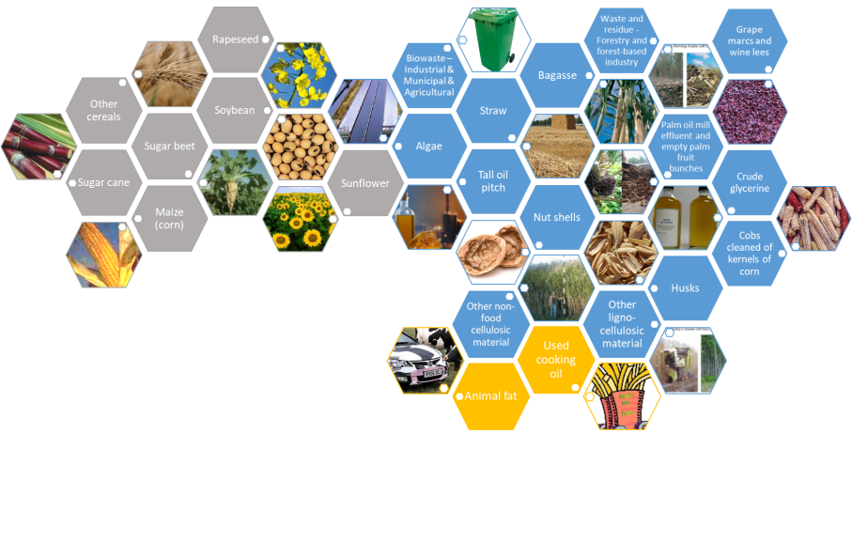
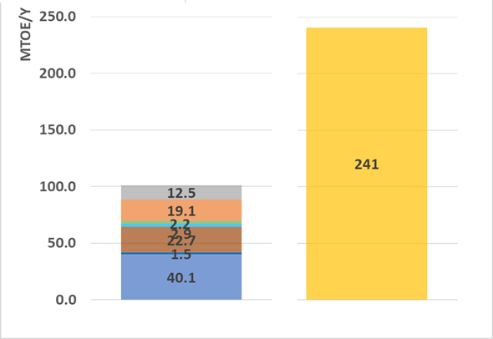
Summary
Resources
Processes
Renewable diesel fuels
FAME and Paraffins variabilities mainly affect cold flow properties and density
  Lignocellulose
      agricultural & forestry residues
      woody and grassy energy crops (no oil)
      industrial residues (biomass residues)
Transesterification
Hydrotreatment oil
Density is the main EN590 constraint for increasing renewable content. Cold flow property improvement can contribute to increase up to 20 points the renewable content but is feedstock dependent
Fermentation (ATF)
Conv. resources
Advanced resources
Gasification + FT
Blending behavior estimation with conventional fuels could be further improved due to limited data for FAME/paraffins blends
E-Fuel – CO₂
E-Fuel – Lignoc.
Competition with other sectors especially for paraffins in the next decade
Hydrotreatment Lignoc.
Used oil or animal fats
Processes upgrade potential/requirements:
pre-treatment/process opti for various feedstocks
H₂ integration for further GHG reduction
Better LCA/TEA evaluation (standard for LCA)
Production capacity increase to convert biomass potential
  Atmospheric CO₂ + renewable energy (Direct Air Capture)
  industrial off-gases (Concentrated CO₂ sources)
ATD
HDT
TRANS
Gasif+FT
Biomass and green H₂ potential availability ➔ Production potential up to 24-51% of expected middle distillate demand by 2030

Slide 16

Read more
  Concawe report
    https://www.concawe.eu/wp-content/uploads/Rpt-22-18.pdf

Slide 17
Roland Dauphin
Roland.dauphin@concawe.eu
fuels@concawe.eu

Slide 18
WP1.1 & WP1.2 – Energy paths review
(1) agricultural & forestry residues
(2) woody and grassy energy crops (ex. Carinata plant to oil)
(3) industrial residues (biomass residues)
(4) atmospheric CO₂ + renewable energy (Direct Air Capture)
(5) UCO & animal fat
(6) industrial off-gases (Concentrated CO₂ sources)
  Transesterification
  Triglycerides hydrotreatment
  Fermentation
  Gasification + Fischer-Tropsch
  e-fuel
Sustainable components limited to Paraffinic and FAME components
Categories
  Lignocellulose
      agricultural & forestry residues
      woody and grassy energy crops (no oil)
      industrial residues (biomass residues)
  Triglycerides
      UCO & animal fat
      energy crops (ex. Carinata plant to oil)
  CO2
      atmospheric CO2 + renewable energy (Direct Air Capture)
      industrial off-gases (Concentrated CO2 sources)

Slide 19
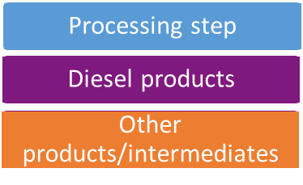

Processes from lignocellulose
Legend
Fermentation - ATD
Direct fermentation
to Fatty acids
Gasification - FT
eFuel – Lignoc.
Hydrotreatment
Lignoc.
Lignocellulose
Crushing
Torrefaction
Pyrolysis
Fermentation
Ethanol
Lignocellulose
Oligomerisation
Hydrogenation/Fractionation
Diesel
Ren. Naphta
SAF
Dehydration
Separation
Hydrolysis
Lignocellulose
Separation
Diesel FAME
Oleochem.
Fermentation
(Esterification/ Transesterification)
(Purification)
Renew. elect.
Water
Lignoc.
Desalination
Pre-treatment
Fluidified bed
Entrained bed
Air separation unit / Steamer
Electrolyser
Gasification
Biogas cleaning
Lignocellulose
Acid hydrolysis
Diesel
Hydrotreatment
Preparation
SAF
Pre-treatment
Condensation
Other
Filtration
FT
Hydrogenation/ Isomerisation
Diesel
SAF
Naphta
WGS
Solvent wash
CO2 extract
Absorption
FT
Hydrogenation/ Isomerisation
Diesel
SAF
Naphta
RWGS
H2
Paraffinic Distillate
FAME
Paraffinic Distillate
Paraffinic Distillate
Paraffinic Distillate

Slide 20
Processes from triglycerides AND CO2
Legend
Transesterification
Hydrotreatment of triglycerides
WCO / Energy crop / Animal fat
eFuel – CO2
Filtration
FFA distillation
Deacidification
Degumming
Washing/ Absorption
Alkali neutralization
Separation
Drying
(Polystyrene removal)
Bacteria treat.
Renewable electricity
Water
CO2
Desalination
WCO / Animal fat / Energy crop
Pretreatment
Diesel
Hydro-isomerization ad Hydrocracking
Hydrogenation and Decarboxylation
SAF
Electrolyser
Evaporation (alcohol recycling)
FT
Hydrogenation/ Isomerisation
Diesel
SAF
Naphta
RWGS
Washing
Purification
Base Homogeneous Transesterification
Separation
Diesel FAME
Glycerol
Acid Esterification
Cake
H2
Paraffinic Distillate (HVO)
Paraffinic Distillate
FAME

Slide 21
Co-Processing Possibilities
Pathways | CP Possibility | Max CP Ratio identified in lit. | CP Input Location | Input Product | Comment | Ref.
Gasification + FT | Yes | 7% ª | VD+HC | FT wax | Gasification -> FT -> wax -> VD+HC. Other locations possible but less favorable. | [5]
eFuel – CO₂ | Yes | 7% ª | VD+HC | FT wax | E-fuel -> FT -> wax -> VD+HC | [426]
eFuel – Lignoc. | Yes | 7% ª | VD+HC | FT wax | E-fuel -> FT -> wax -> VD+HC
Fermentation (ATD) | Yes | 10% | Hydrogenation/FCC | Oligomerization product | ATD and ATJ follow the same process, so we can refer to the available options for ATJ. | [5]
Hydrotreatment of triglycerides | Yes | 25% ^{b} | Direct | Raw oil from Energy crops, waste cooking oil, animal fat | Co-processing of RSO/AGO, HTL/VGO. Requires novel catalysts. Efficiency and product quality (e.g., cold flow properties) of the co-processing still need to be improved to be competitive. | [6-9, 10]
Hydrotreatment Lignoc. | Not identified
Transesterification | Not identified
Nomenclature:
CP | Co-processing | VD | Vacuum distillation | FT | Fischer–Tropsch | HC | Hydrocracking
ATD | Alcohol-to-Diesel | FCC | Fluid catalytic cracking | AGO | Atmospheric gas oil | VGO | Vacuum gas oil
RSO | Rapeseed oil | HTL | Hydrothermal liquefaction product
ª assumed similar to Gasification+FT
^{b} lab-scale results
Notes:
Jong, Sierk de; Hoefnagels, Ric; Faaij, André; Slade, Raphael; Mawhood, Rebecca; Junginger, Martin (2015): The feasibility of short-term production strategies for renewable jet fuels - a comprehensive techno-economic comparison. In Biofuels, Bioprod. Bioref. 9 (6), pp. 778–800. DOI: 10.1002/bbb.1613.
Doliente, Stephen S.; Narayan, Aravind; Tapia, John Frederick D.; Samsatli, Nouri J.; Zhao, Yingru; Samsatli, Sheila (2020): Bio-aviation Fuel: A Comprehensive Review and Analysis of the Supply Chain Components. In Front. Energy Res. 8, p. 110. DOI: 10.3389/fenrg.2020.00110.
Alves, C. M., Valk, M., de Jong, S., Bonomi, A., van der Wielen, L. A. M., and Mussatto, S. I. (2017). Techno-economic assessment of biorefinery technologies for aviation biofuels supply chains in Brazil. Biofuels Bioprod. Biorefining 11, 67–91. doi: 10.1002/bbb.1711
Mawhood, Rebecca; Gazis, Evangelos; Jong, Sierk de; Hoefnagels, Ric; Slade, Raphael (2016): Production pathways for renewable jet fuel: a review of commercialization status and future prospects. In Biofuels, Bioprod. Bioref. 10 (4), pp. 462–484. DOI: 10.1002/bbb.1644.
Tanzil, Abid H., et al. "Production of Sustainable Aviation Fuels in Petroleum Refineries: Evaluation of New Bio-Refinery Concepts." Frontiers in Energy Research (2021): 665.
Fogassy, Gabriella, et al. "From biomass to bio-gasoline by FCC co-processing: effect of feed composition and catalyst structure on product quality." Energy & Environmental Science 4.12 (2011): 5068-5076.
Carmona, H. D. P., Akhmetzyanova, U., Tišler, Z., & Vondrova, P. (2020). Hydrotreating atmospheric gasoil and co-processing with rapeseed oil using supported Ni-Mo and Co-Mo carbide catalysts. Fuel, 268, 117363.
de Paz Carmona, H., Svobodova, E., Tišler, Z., Akhmetzyanova, U., & Strejcova, K. (2021). Hydrotreating of Atmospheric Gas Oil and Co-Processing with Rapeseed Oil Using Sulfur-Free PMoCx/Al2O3 Catalysts. ACS omega, 6(11), 7680-7692.
Badoga, S., Alvarez-Majmutov, A., Xing, T., Gieleciak, R., & Chen, J. (2020). Co-processing of hydrothermal liquefaction biocrude with vacuum gas oil through hydrotreating and hydrocracking to produce low-carbon fuels. Energy & Fuels, 34(6), 7160-7169.
https://www.sciencedirect.com/science/article/pii/S0016236119309275
426. http://www.flexchx.eu/pdf/webinar2021/Presentations_Webinar_19012021.pdf

Slide 22
Summary
Resource | Process |  | Comments / Research needs
Lignocellulose | Fermentation ATD | Paraffinic distillate | Industrialised technology Flexibility to other products ➔ diesel or kerosene optimisation impacts?
Lignocellulose | Fermentation to oil | FAME | Limited industrialised projects Blending constraints
Lignocellulose | Gasification - FT | Paraffinic distillate | Technology close to industrialization - Optimisation prospects Flexibility to other products but integrability and adaptation to lignocellulose required
Lignocellulose | Hydrotreatment Lignoc. | Paraffinic distillate | Limited industrialised projects
WCO / Animal fat / Energy crop oil | Hydrotreatment of triglycerides | Paraffinic distillate (HVO / HEFA) | Industrialised technology Application to a wider range of resources Integration of renewable H2?
WCO / Animal fat / Energy crop oil | Transesterification | FAME | Industrialised technology – adapted to small scale /close to resource Blending constrains
Lignocellulose | eFuel – Lignoc. | Paraffinic distillate | eH2 and RWGS technology to industrialise Optimisation prospects (electrolysers, CO2 capture, CO/CO2 from biomass) High flexibility to other fuels
CO2 | eFuel – CO2 | Paraffinic distillate
Excluded.
Lim. 7 paths

Slide 23
WP1.3 – LCA & TEA assessment
(1) Lignocellulose
(2) Energy crops
(3) atmospheric CO₂ + renewable energy (Direct Air Capture)
(4) UCO & animal fat
  (1) Transesterification
  (2) oil hydrotreatment
  (3) fermentation
  (4) gasification + Fischer-Tropsch
  (5) e-fuel
LCA methodology (functional unit, system boundaries and allocation)
Value of the environmental impacts & the different sources of impacts (e.g. process steps)
Cost breakdown and breakeven price

Slide 24
WP1.3 – LCA & TEA assessment
Key take aways by 2030 for the main energy paths
Resources flexibility
A few industrialised pathways
(ex. hydrotreatment, transesterification)
High GHG reduction potential
Fuel cost
Resources variability and related pre-treatment
GHG reduction and potential further increase with CO₂ capture or green H₂
Know-how for intermediate products (alcohols) and fuels
E-fuel: ready by 2030? (CO₂ capture/green H₂ required)
Biomass mobilisation & Renew. Energy production are essential
Other impacts than CO₂ (e.g. biodiversity)
LCA lacking of standard and limited consequential analyses
Competition with other sectors (ethanol as a chemical platform!)
Gasif + FT: high capital invest.
Strenghts
Weaknesses
Opportunities
Threats
The main challenge is to work on incentives that are required to overcome threats and consolidate opportunities

Slide 25
CO₂ impact per fuel pathway
*syngas fermentation to ethanol followed by fuel production via alcohol condensation (Guerbet reaction), dehydration, oligomerization, and hydrogenation
**syngas fermentation to ethanol followed by fuel production via carbon coupling/deoxygenation (to isobutene), oligomerization, and hydrogenation
Notes:
We focus here only on the LCA results with the details of the ressource
For hydrothreatment , gasification and efuel the results are quite consistent
diversity of results (atj and transterification) due to differences in resources but also in impact calculation methods

Slide 26
WP1.4 & 1.5 Competition and synergies
Objective:
  Estimate the potential diesel production from biomass availability
  Identify potential competition with other sectors considering the “Fit for 55” package
Hypotheses:
  Diesel or distillate mass yields from literature review (data from WP1.3)
  Real production capacity which refers to current infrastructures is not considered
  Resource availability data from Imperial College (IC) report* has been used as reference
    Resource: It does NOT include any food & feed crop biofuels (1G) / for each specific resource displayed in the literature, resource type defined by IC have been considered for this analysis
    Scenarios: Scenario 1 and 3 evaluated by IC were considered
    Scope: Europe by 2030
Scenario 1 : Low mobilisation (LOW)
Scenario 3 : Enhanced availability through R&I & improved mobilisation (HIGH)
*Sustainable biomass availability in the EU, to 2050 – Imperial College London
Notes:
Mtoe is an acronym that stands for million or mega tonnes of oil equivalent. The unit quantifies the amount of energy released when burning one million tonne of crude oil. The respective Mtoe value of different fuels varies.
Scenario :
LOW : This scenario assumes low mobilisation of biomass for both 2030 and 2050
MEDIUM : Improved mobilisation of biomass in selected countries
HIGH : Inhanced availability of biomass through R&I and improved mobilization
All markets : including energy and non-energy sectors
Bioenergy : including only energy sector

Slide 27
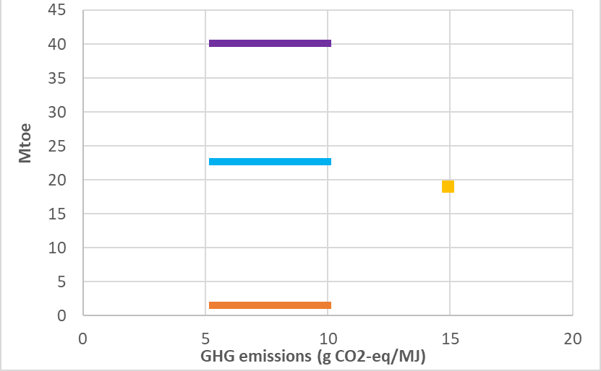
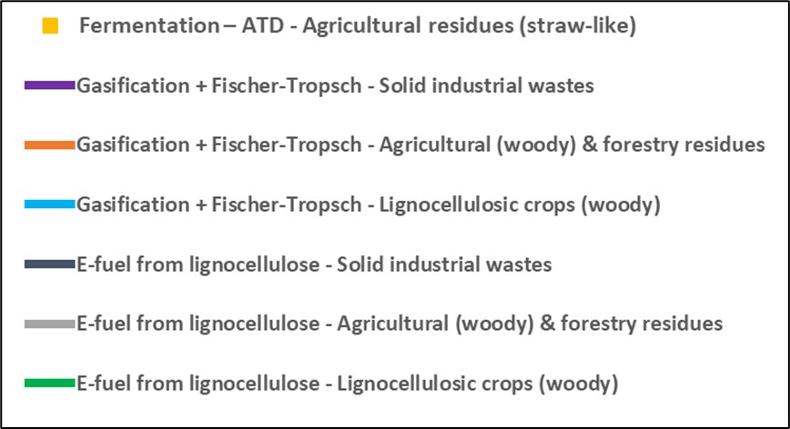
POTENTIAL PRODUCTION based on high Mob. biomass mobilisation VS GHG emissions
Maximum projected renewable fuel production quantity by 2030 for high energy pathways production previously identified namely Fermentation, Gasification + FT. The related feedstocks are listed in Annex IX A of RED II/2018.
Oil hydrotreatment and transesterification have been considered as negligible compared to other paths.

Slide 28
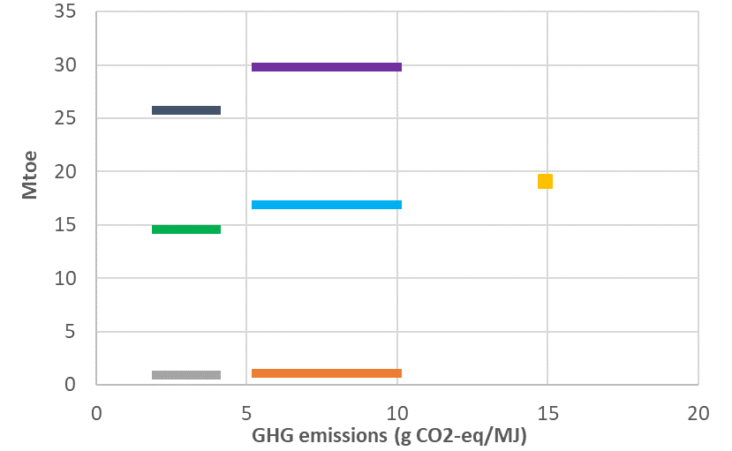
POTENTIAL PRODUCTION including regulatory objectives for RFNBO by 2030
Addition of e-fuel from lignocellulose assuming that the fit for 55 target is reached for RFNBOs with liquid fuels only. This includes 2.6% of the total energy demand (0.7% for aviation sector)
This hypothesis is also quite optimistic for transport availability considering that renewable H₂ contribution to other sectors is included in the objective

Slide 29
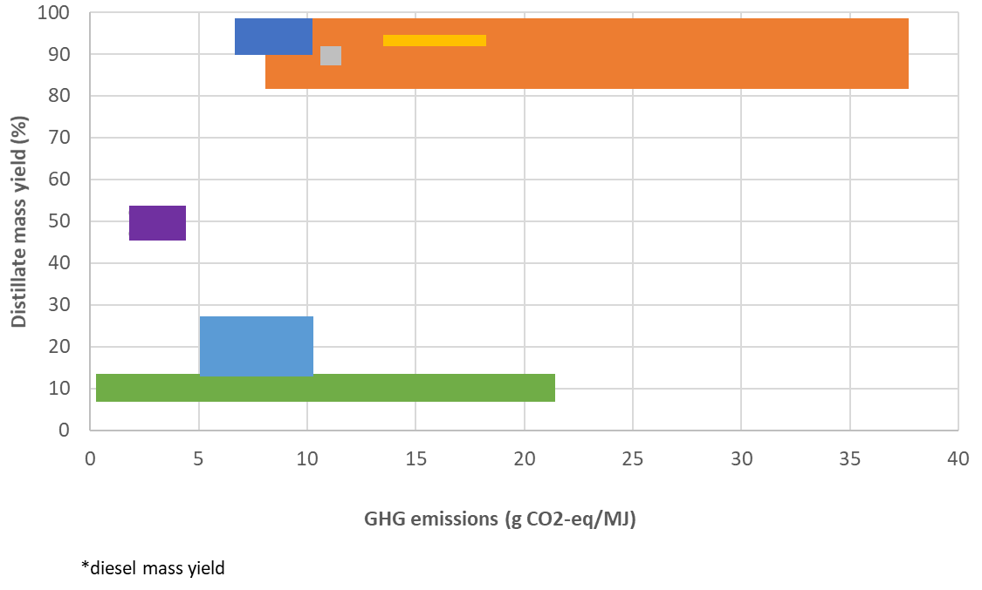
Mass yield and GHG emissions
The sensitivity to the resource can be very different for some energy pathways
  Fermentation - AtD
  Transesterification – WCO
Lignocellulosic biomass | GWP impact*** (g CO2-eq/MJ)
Wood chips* | 1.6
Wood chips** | 10
Corn stover | 21
Agricultural residues | 14.9
*syngas fermentation to ethanol followed by fuel production via alcohol condensation (Guerbet reaction), dehydration, oligomerization, and hydrogenation
**syngas fermentation to ethanol followed by fuel production via carbon coupling/deoxygenation (to isobutene), oligomerization, and hydrogenation
***See presentation WP1.3
WCO | GWP Impact*** (g CO2-eq/MJ)
WCO (China) | 37.4
WCO (JRC) | 8.3
Oil hydrotreatment – WCO* | Transesterfication – WCO*
Oil hydrotreatment – animal fats* | Transesterfication – animal fats*
Gasification + FT | E-fuel from lignocellulose
Fermentation – ATD

Slide 30
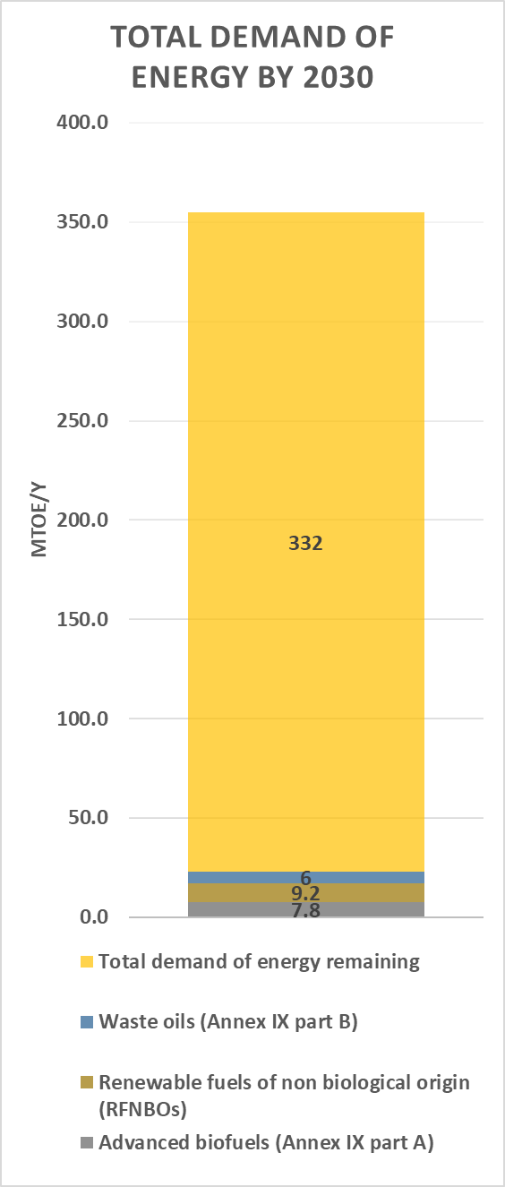
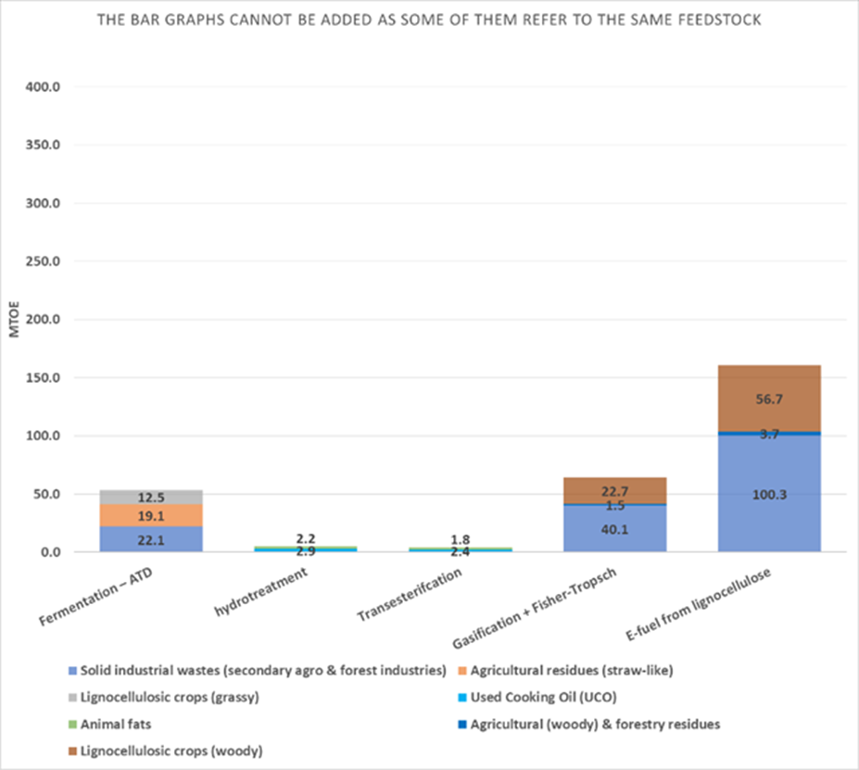
ENERGY DEMAND AND Renew. DIESEL PRODUCTION Capacity based on biomass availability BY 2030
The bar graphs cannot be added as some of the energy paths use the same resources
RFNBOs (9.2 Mtoe): e-fuel or e-fuel from lignocellulose ?
Advanced biofuels (Annex IX) (7.8 Mtoe): could be supplied through all identified pathways
Waste oils (Annex IX part B) (6 Mtoe): could be supplied through oil hydrotreatment (5.1 Mtoe) or transesterification (4.2 Mtoe) but the limit may not be reached by 2030

Slide 31
Product Properties
Products variability collected from literature review (synthesis from WP 1.1 to 1.3)
Name | Density [kg/m3] | Cetane Number | Kinematic Viscosity [mm2/s] | Flash Point [dgC] | Cold Filter Plugging Point [dgC]
Hydrotreatment Products
HDT EC (Worst) | 780 | 80 | 3.6 | 140 | 21
HDT EC (Best) | 780 | 80 | 3.6 | 140 | -44
HDT WCO (Worst) | 780 | 71 | 3 | 42 | 19
HDT WCO (Best) | 780 | 71 | 3 | 61 | -11
White Diesel (WCO) | 753 | 77 | 3.5 | 116 | 20
Fischer–Tropsch Products
FT (Worst) | 770 | 70 | 3 | 59 | 0
FT (Best) | 790 | 70 | 3 | 59 | -22
Transesterification Products
TRANS EC (Worst) | 876 | 51 | 5.6 | 130 | 11
TRANS EC (Best) | 888 | 62 | 2.7 | 193 | -9
TRANS WCO (Worst) | 860 | 51(49) ª | 5.3 | 135 | 2
TRANS WCO (Best) | 897 | 57 | 4 | 196 | 2
TRANS AF (Worst) | 830 | 51(50) ª | 6.9 | 50 | 14
TRANS AF (Best) | 883 | 60 | 3.5 | 175 | -20
Coloring on Numbers:
(EU)EN590
(EU)EN590-extended
Outside both standards
ª Assumed that the small gaps in CN from the standard could be eliminated by additives

Slide 32
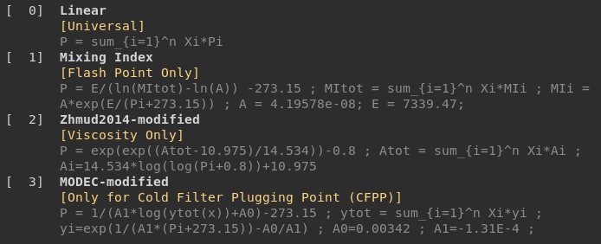
Mixing RULES
  Density [0]
  linear blending rule : density is a property that is weighted by volume
  Flash-point [1]
  Non-linear blending rule : the more volatile fraction has a greater influence
Viscosity [2]
  Non-linear blending rule : the fluid base has a predominant weight which gives the mixture a much lower viscosity than that calculated by volume weighting
Cetane number [0]
  linear blending rule is considered as a first approximation (HC components)
  CFPP [3]
  Non-linear blending rule: existing models mainly based on compositional descriptors (FAME, SFAME, unsaturated, long-chain suturation factors (LCSF)) and solid-liquid equilibrium.
Semwal & Varshney 1995, seems to be the best
MODEC-modified: could be a conservative option
Vrablik et al. 2019: Not favored
Research need identified as limited data exist for FAME/Paraffins blends

Slide 33
Standards
  2 boundaries considered for common countries in Europe
 | (EU)EN590 |  | (EU)EN590-extended
 | EN590 + CFPP (Class F, -20℃) |  | EN590 + EN14214 + EN15940 + CFPP (Class F, -20℃)
Property | Min | Max | Min | Max
Density [kg/m3] | 820 | 845 | 765 | 900
Cetane Number | 51 | --- | 51 | ---
Flash Point [℃] | 55 | --- | 55 | ---
Kinematic Viscosity [mm2/s] | 2 | 4.5 | 2 | 5
CFPP [℃] | --- | -20 | --- | -20
  Average properties considered for the diesel base fuel
Properties of the B7 Used
Density | 833
CN | 51
KV | 3.3
FP | 55
CFPP | -25

