Slide 1
Analytical technology exchange to meet health & environmental regulatory challenges for UVCBs Regulatory challenges from Environment & Human Health Perspectives
November 8th, 2023 - Helsinki
Delina Lyon & Nicholas Synhaeve

Slide 2
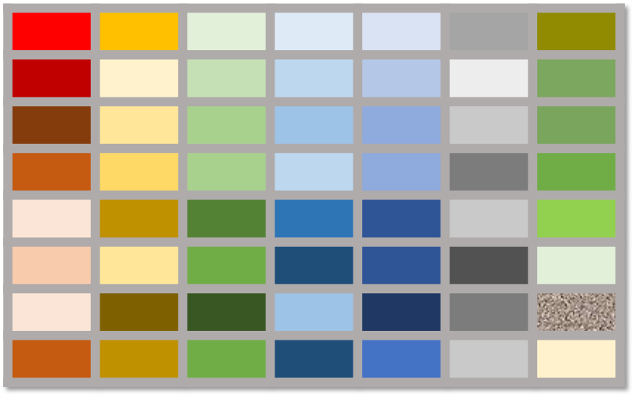
Hazard assessment for UVCBs
There are 3 basic health & environmental hazard endpoints:
Due to the complexity of hydrocarbon UVCBs, it is not always possible to rely on whole substance hazard data. Based on regulatory guidance, we think about hydrocarbon UVCBs in 3 ways:
Toxicity
Biodegradability/Persistence
Bioaccumulation
whole substance
hydrocarbon blocks
constituents

Slide 3
Hazard assessment for UVCBs
 | Toxicity (T) | Biodegradation/ Persistence (P) | Bioaccumulation (B)
Whole substance | - Overall composition for read-across | (same as for T) | (same as for T)
Hydrocarbon block (HCB)/Constituent group | - Aromatic content (esp. PAHs) for Human Health - Relative concentration of hydrocarbon blocks | - Relative concentration of HCBs - Structures of constituents within a HCB | (same as for P)
Constituent | - Identify specific constituents of concern | (same as for T) - Substructural features driving P | (same as for T)

Slide 4
REACH and read-across
REACH regulation allows for grouping of substances and use of read-across of data between similar substances to fill data gaps
REACH Annex XI
General rules for adaptation of the standard testing regime set out in Annex VII to X
Grouping: ECHA RAAF for UVCBs, 2017:
”For UVCBs, grouping on the basis of structural similarity may become even more complex, e.g. due to the presence of more constituents in the substances, potentially higher variations in the concentrations of the constituents and sometimes unknown constituents. Such grouping proposals also clearly require extensive explanations and justified criteria for group membership.” (p30)

Slide 5
REACH and read-across
REACH regulation allows for grouping of substances and use of read-across of data between similar substances to fill data gaps (cont’d)
Read-across: ECHA Advice on Using Read-Across for UVCB substances, 2022:
“If it can be demonstrated that the identification of all individual constituents is not technically possible or impractical, the structural similarity must be demonstrated by other means. Therefore, the registrant must provide a justification explaining why the other means enable a quantitative and qualitative comparison of the actual composition between substances.” (p10)
“An example of demonstrating structural similarity by other means could be “fingerprinting” of constituents and their concentrations in compositions using chromatographic methods to provide an overview (fingerprint) of the constituents, particularly where there are common constituents.” (p10)
“Key issues in evaluating the acceptability of the fingerprinting method will be: … the provision of information on a sufficient proportion of constituents in a substance (i.e. covering >95 % of the constituents of a substance)…” (p10)
“ …the concentration of constituents in at least five independent samples of the substance must be measured. The independent measurements must be from different production batches of the substance as produced by all the registrants.” (p7)

Slide 6
What analytical information would support structural (compositional) similarity for UVCBs?
Whole substance composition for development of the hydrocarbon space map
Comparison of whole substance compositions for selecting (worst-case) representative sample(s)
Groups of relevant constituents
Specific constituents of concern
Other?

Slide 7
Example: Hydrocarbon space map of gas oils
Selection of representative samples for biological similarity assessment (human health)

Slide 8
Use of read-across for HH toxicity
Analytical/ Compositional Data
Describe hydrocarbon (HC) chemical space in all registered substances; support sample selection for in-vivo testing
In-vivo reproductive screening and in-vitro supporting studies
Integrative data analysis
Integration of composition, toxicity, biological activity / NAM data for chemical-biological similarity and grouping assessment, confirmation of test samples and building read-across hypotheses
Subchronic / Developmental / Reproductive Toxicity
Complete higher-tier requirements with targeted animal testing data
Biological similarity of relevant HC space; OECD 422s and other biological data
Step 1
Step 2
Step 3
Step 4
Analytical characterisation forms the first critical step in HH hazard testing strategy

Slide 9
Read-across justification for ENV toxicity
Tying chemistry to mechanism of toxicity
Have GCxGC-FID data (hydrocarbon block) and biomimetic extraction-Solid Phase Microextraction (BE-SPME) to measure bioavailability
Use the hydrocarbon block data for PetroTox predictions of aquatic and sediment/soil toxicity of available samples
Use BE-SPME data to identify most bioavailable and therefore toxic samples
To allow a conservative assessment, the most toxic sample based on BE SPME and PetroTox will be selected for aquatic, sediment and terrestrial toxicity testing and read-across to the other category members
Select this sample for testing
BE-SPME data
PetroTox/BE-SPME
PetroTox: Toxicity predictions using GCxGC data
Samples
Sample #

Slide 10
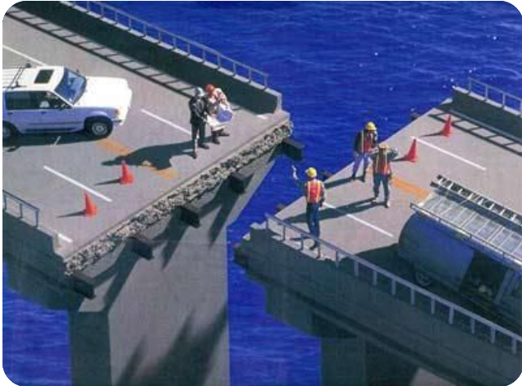
Without an analytical solution... no read-across
Huge increase in number of (eco)toxicology tests needed
I.e. on each substance within a category
Significant increase of experimental animals needed
Significant impact on timing and delivery of testing results
Even in context of correct sample selection for toxicology testing (i.e. without underestimating the hazard), better understanding of (specific) constituents might be required
WordPress.com

Slide 11
What kind of (additional to Annex VI) analytical data may be needed for hydrocarbon UVCB hazard assessment?
e.g., GCxGC data to enable predictions of aquatic toxicity
e.g., PAH content as key driver of toxicity
Other?

Slide 12
Hazard assessment for UVCBs
 | Toxicity (T) | Biodegradation/ Persistence (P) | Bioaccumulation (B)
Whole substance | - Overall composition for read-across | (same as for T) | (same as for T)
Hydrocarbon block (HCB)/Constituent group | - Aromatic content (esp. PAHs) for Human Health - Relative concentration of hydrocarbon blocks | - Relative concentration of hydrocarbon blocks - Structures of constituents within a HCB | (same as for P)
Constituent | - Identify specific constituents of concern | (same as for T) - Substructural features driving P | (same as for T)

Slide 13
Additional analytical data needs
Whole Substance
- Alternatives to GCxGC to get greater coverage of the whole hydrocarbon space to support read-across
Blocks
- Improve the justification for hydrocarbon blocking/grouping (e.g., identify chemical classes)
Constituents
- More information on (sub)structural features (e.g., branching)
- Detect and quantify specific constituents (e.g.,PAHs, C&L marker substances, etc.)

Slide 14
What criteria does an analytical approach need to fulfil to support hazard assessment?
Coverage
Granularity
Repeatability
Others?

Slide 15
Information of interest to Concawe
Coverage & granularity of the method
General (sub)structures of constituents is normally sufficient
Justify assessment of similarity, especially for use in read-across arguments
Associated benefits & limitations
Strengths vs weaknesses of each approach, e.g., mass spec is poorer at quantification
Reliability/repeatability of a method
How to confirm identity if standards are not available for (sub)structures
EJ1046374.pdf (ed.gov)

