Slide 1
Challenges faced by petroleum UVCB substances in meeting the requirements for analytical data in REACH substance hazard assessment
Concawe UVCB workshop – 8th November 2023 - Helsinki
Carol Banner

Slide 2
Agenda
01
Petroleum UVCB substance characteristics
02
Progress to date and challenges ahead

Slide 3
Petroleum UVCB substance characteristics
01

Slide 4









Petroleum UVCB Substances
C1
-> Chemicals (CEFIC)
C10
C20
C30
142 Petroleum Substances (PS) actively registered and managed by Concawe (>4000 registrations)
C40
Crude Oil
Boiling
C50
Vac. Dist.
->C50+

Slide 5
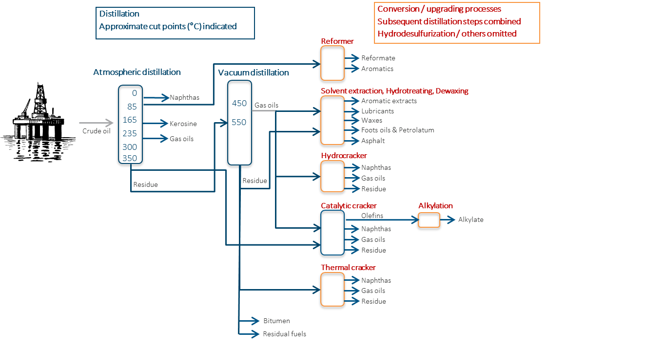
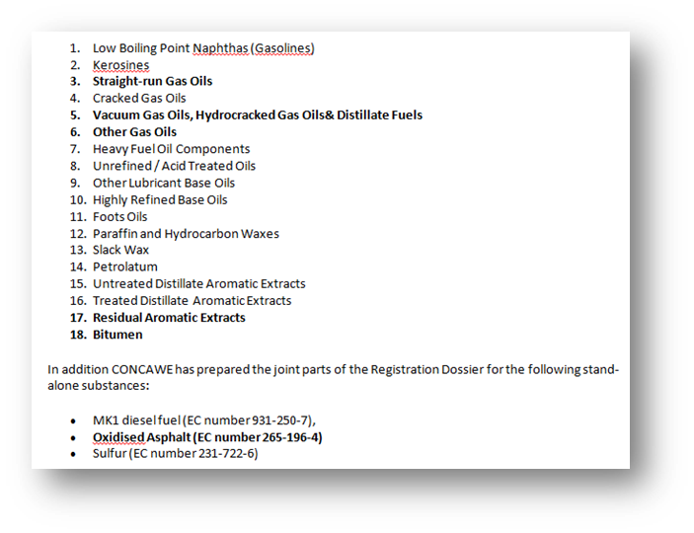
Substance grouping based on boiling/carbon range and manufacturing process
Examples of processes in refineries
Inherent variability in crude oil composition
Petroleum substances are manufactured to meet performance characteristics rather than specific chemical composition

Slide 6
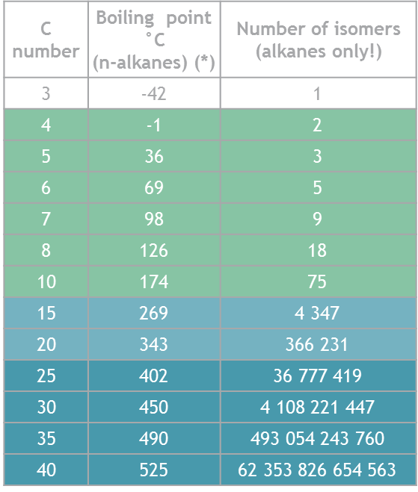
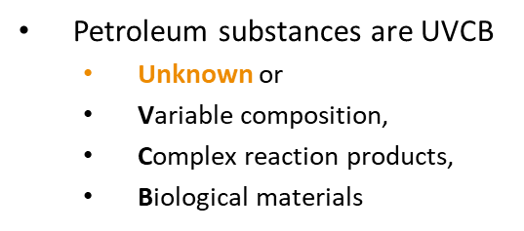
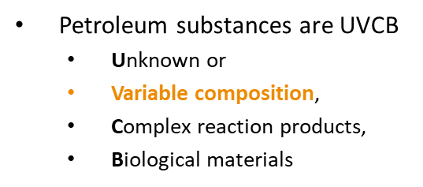
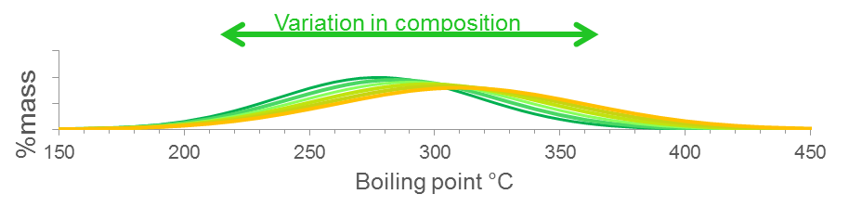
Petroleum UVCB Substances characteristics
Due to the high number of molecular hydrocarbon constituents,
  Not all individually identified
  However constituents are collectively characterized
Petroleum Substances are variable by nature
  Variability is limited to meet product specification
  Petroleum substances form a continuum whereby physical-chemical properties overlap in the hydrocarbon space
Notes:
- Explain where variability comes from (crude oil source, manufacturing processes)
- Analytical methodology, inter-lab variation will lead to variation in analytical data

Slide 7
Petroleum substance characterization
C1
C10
C20
LOW
LOW
SIMPLE
DETAILED
C30
C40
Crude Oil
Boiling
C50
UNIFORM
Vac. Dist.
HIGH
HIGH
MULTIPLE
GENERIC
->C50+
Number of constituents
Molecular weight
Chemical
functionality
Analytical granularity
Specified Constituents

Slide 8
Progress to date & challenges ahead
02

Slide 9
Demonstrating petroleum substance structural similarity to support read across
C1
Justify why identification of all individual constituents is not technically possible or impractical
Measure concentration of constituent groups
Characterise the variability in constituent groups across 5 samples
Characterise >95% of constituent/groups of constituents
C10
C20
C30
C40
Crude Oil
Boiling
C50
Vac. Dist.
->C50+

Slide 10
Demonstrating petroleum substance structural similarity to support read across
Category | Predominant carbon number range | Technique / Method to demonstrate structural similarity
Naphtha | 5-12 | PIONA DHA
Kerosine | 9-16 | GC x GC
Gas Oils | 12-30 | GC x GC
Paraffin Waxes | 20-40 | ?
Heavy Fuel Oils | 20-50 | ?
Lubricant Base Oils | 20-40 | ?
Bitumen | 30->100 | ?
C1
C10
C20
C30
C40
Crude Oil
Boiling
C50
Vac. Dist.
->C50+

Slide 11
Example: Hydrocarbon space map of gas oils
Mapping of applicability domain – all samples

Slide 12
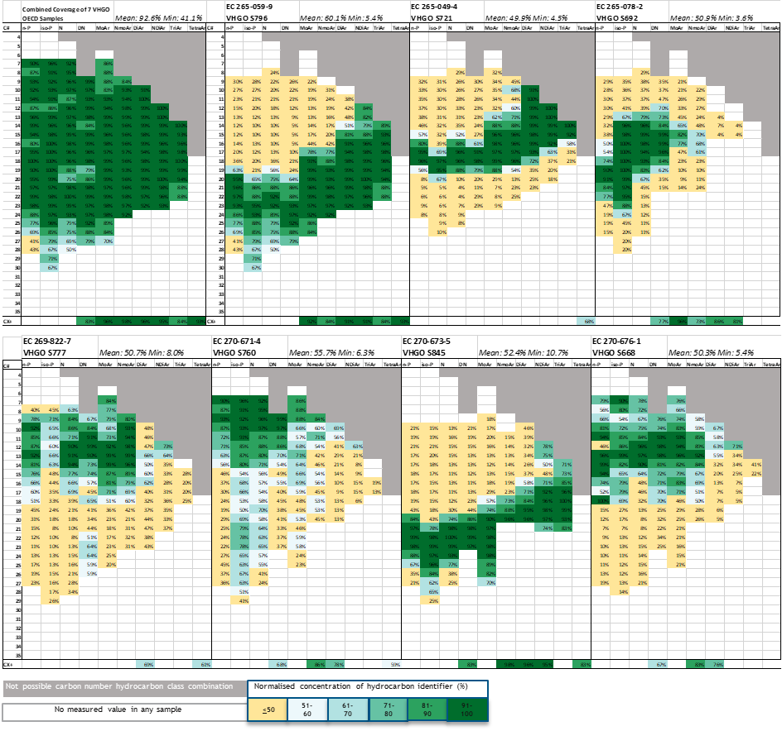
Example: Hydrocarbon space map of gas oils
Selection of representative samples for biological similarity assessment (human health)

Slide 13
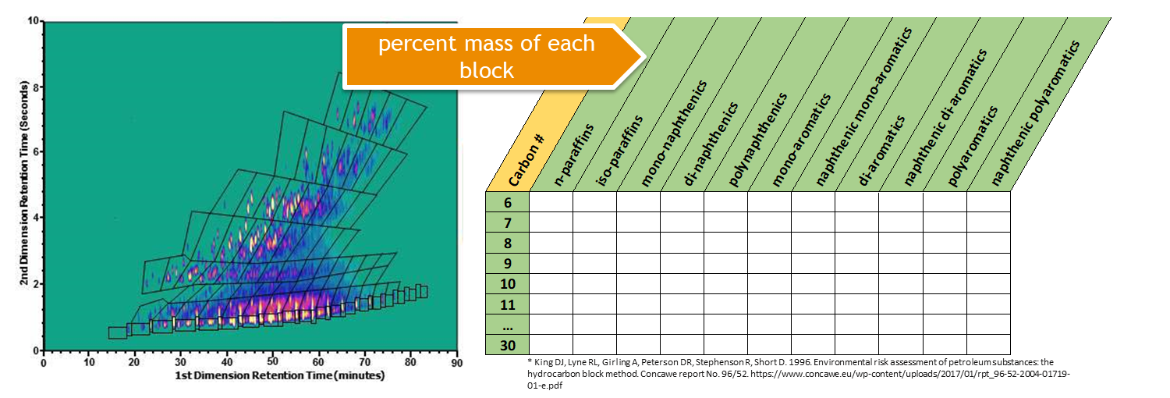
Example: Predictions of environmental toxicity
Selecting samples for testing by using analytical data to predict the most toxic
GCxGC analysis provides compositional information on a substance by dividing up the chemical space into hydrocarbon blocks, and then allocating percent concentration to each block.
Using the target lipid model to predict the toxicity of each hydrocarbon block, it is possible to sum up the toxic units per block to predict the toxicity of the whole substance.
Select this sample for testing
Toxicity
Toxicity predictions
Sample #

Slide 14
Comprehensive and quantitative compositional data on heavier petroleum substances remains a challenge
Category | Predominant carbon number range | Technique / Method
Paraffin Waxes | 20-40 | ?
Heavy Fuel Oils | 20-50 | ?
Lubricant Base Oils | 20-40 | ?
Bitumen | 30->100 | ?
C1
C10
C20
C30
C40
Crude Oil
Boiling
C50
Structural similarity as basis for read across
Vac. Dist.
Predicted environmental toxicity
->C50+

Slide 15

Identification of specific constituent (sub)structures
REACH requires identification of constituents which are Persistent, Bioaccumulative & Toxic (PBT) or very Persistent & very Bioaccumulative (vPvB)
This requires an understanding of the constituents and the types of (sub)structures present in the petroleum UVCB substances
Improved understanding of the diversity of available substructural features can aid in linking properties, like biodegradability, to specific constituents/hydrocarbon blocks

Slide 16
Carol Banner
carol.banner@concawe.eu

