Slide 1
Mocrinis II Workshop Manufacture of Mineral Oil and Wax Composition and Specifications
Laurent Jouanneau, Concawe STF-33

Slide 2
Agenda
Manufacture of Mineral Oil and Wax
Impact on Substance Composition
Definitions, Uses, Specifications, Regulations

Slide 3
Part 1
Manufacture of Mineral Oil and Wax
Impact on Substance Composition

Slide 4
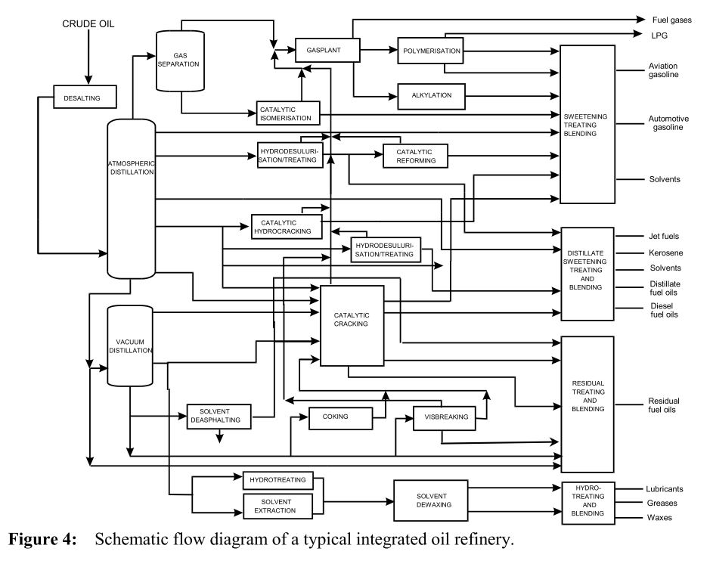
Complex Flow Diagram of typical integrated Refinery
Lubricant Base Oils, White Oils, Wax: < 10% of total refinery production
Typical
Carbon Range
C20 – C50
C20 – C90
Source: EFSA Opinion 2012
Notes:
Here is a flow scheme of a typical integrated refinery, that makes lubricant vbase oils in addition to fuels.
The objective here is to show that most of the production units, and most of the volume of production is for products over than base oils and waxes.
These are gases, gasoline, gazole, kerosene and fuel oils, as well as naphta that feed the petrochemical units.
Lubricating oils and wax typically account for less than 10% of total production in those refineries.
Carbon number range typically between C20 and C50 for Lubricating base oils and C20 to C90 for wax.
Voice over : Hydrocarbon solvents (Carbon number below C20) out of scope of mineral oils and will not be covered in our discussions today.

Slide 5
Hydrocarbon type molecules from crude are selected during Refining
Crude Oil: “complex” matrix of naturally occurring hydrocarbons (“UVCBs”-Substances of Unknown or Variable composition, Complex reaction products or Biological materials) which can be orderly classified
by molecular weight and by molecular structure
in limited number of chemical families because of natural origin of crude
Refining will select the desired molecules for the targeted applications
HYDROCARBON
CHEMICAL NAME
STRUCTURE
normal alkanes
Paraffinics
iso alkanes
with/without heteroatoms)
(
S
Mono-cyclo alkanes
Naphthenics
polycyclic alkanes
CRUDE OILS COMPONENTS
(
with/without heteroatoms)
S
Aromatics
mono aromatics
polycyclic aromatics
Metals
(
with/without heteroatoms)
eg. Ni, V, Fe
S
Notes:
Although all of these families of hydrocarbons are present in all crudes, proportions of these various families can vary significantly between different types of crudes. Main big crude families are called paraffinic or naphthenic crudes. Paraffinic crudes are the majority of those refined in the world, naphthenic crudes are produced in Venezuela for example and can have interesting properties in some industrial applications.
Paraffinic molecules are composed of normal alkanes (straight chains) or iso-alkanes (that include branches). They can have heteroatoms like sulfur, or not.
Naphthenic molecules can have one or several cycles, which are all saturated cycles.
Aromatics can have one or several benzenic cycles, but nearly always long aliphatic chains.

Slide 6
Content in various Hydrocarbon types vary with crude type and carbon number/boiling range
Mineral Oil / Wax
300 ºC
700 ºC
Above example: typical hydrocarbon distribution of a lube crude (e.g. Arab Light)
Broad lumping of molecule types in the whole crude
Lubricant Base Oils / Wax / White Oils typically fall in 300°C to 700°C distillation range
Petroleum refining primarily controlled by Boiling range/temperature
Carbon number of distillation cuts estimated from corresponding n-paraffin molecules
Refining is needed to isolate the desired Lubricant Base Oils/Wax/White Oils components
Hydrocarbon solvents (Carbon number below C20) out of scope of mineral oils
Notes:
On this slide we see the compositional makeup of a paraffinic lube crude. Refining is needed to turn this crude into basestock fractions in the 300 to 700 deg.C boiling range

Slide 7
Mineral Base Oils Constituents vs Performance
 |  | Lubricant Base Oils Characteristics |  |  |  | Wax
Molecule | Structure | Viscosity Index | Pour point | Oxidation Stability | Solubility
n-paraffins |  | Excellent | Poor | Excellent | Poor | Main component
Iso-paraffins |  | Good/ Excellent | Good | Excellent | Good
Highly alkylated aromatics |  | Poor | Good | Good | Good
Naphthenics |  | Poor | Excellent | Good | Excellent
Polynuclear aromatics |  | Poor | Poor | Very Poor | Good
“Good” vs “Poor” performance depends on final application
eg “good” for wax is different from “good” for oil
Sulfur and nitrogen in crudes significantly reduced through refinery processing
Sulfur can contribute to oxidation stability in conventionally refined base oil
Nitrogen can contribute to product color and is generally eliminated in processing

Slide 8
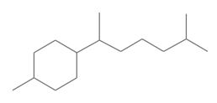
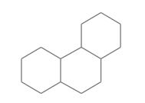
Molecular Structures Waxes and Oils
Waxes
Oils
Wax Fraction or Oil Fraction ?

Slide 9
Molecular Structures Waxes and Oils: Iso-paraffins
Waxes
Oils
Wax Fraction or Oil Fraction

Slide 10
What Mineral Oil- and Wax is / is not
The terms “mineral oil” or “wax” are generic and do not mean the same thing for everyone. Definitions and context is needed to understand the issue.
Refined “mineral oils” and “waxes” are refinery products manufactured to meet specific standards.
While Mineral oil can be chromatographically described as MOSH and MOAH fractions, these fractions do not always represent the products on the market.
MOSH and MOAH does not necessarily mean “mineral oil”.
An isolated MOSH fraction does not imply that ALL saturated hydrocarbons are from mineral oil origin. It can contain natural n-alkanes.
An isolated MOAH fraction does not imply PAC presence neither refinement level.
The MOSH term applied to the saturated fraction of a wax is misleading because MO refers to an “oil”. At 25⁰C an oil is liquid, a wax is solid.
Remember: MOSH and MOAH terms are highly contextual.
Notes:
MOSH and MOAH fractions do not always represent the products placed on the market, because those fractions found in food can come from various origins, other than mineral oils: migrations from materials, natural origin, or also molecules that have been transformed.
An isolated MOAH fraction does not imply PAC presence neither refinement level, because it can be highly alkylated molecules, 1 or 2 rings with long hydrocarbon chains.
MOSH and MOAH terms have to be used in the right context to avoid confusion.

Slide 11
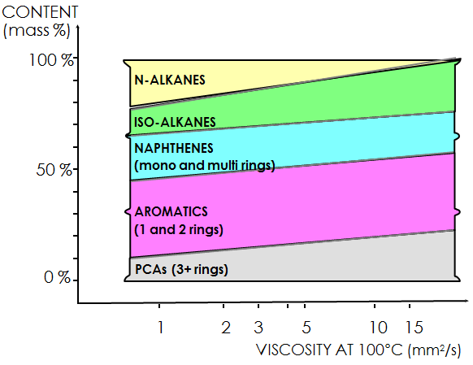
Crude Oil Initial Chemical Composition
The individual hydrocarbon components have diverse and well known performance characteristics and toxicological properties, that will drive refining.
⇨ Low to High Viscosity ⇨
⇨ High to Low Volatility ⇨
Solid at low Temperature
Desired in wax, not in base oils
Best:
Chemical stability
Viscosity stability
Medium :
Chemical stability
Viscosity stability
Dermal toxicity
Chemical unstability
😐
Actual content in each hydrocarbon type category varies with crudes
☺
☺
😐
☹
Refining will select the molecules from the crude oil in controlled manner to set the final chemical composition (and properties) of the mineral oil
Notes:
Now we will look in more details at which of the types of hydrocarbons are desired in our mineral oils and wax, and how refining is going to select them.

Slide 12
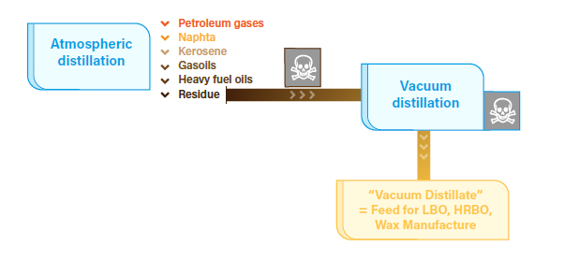
Base Oil, Wax, White Oil Manufacture Step 1 : Distillation
Notes:
First production unit in all refineries is the atmospheric distillation. It separates the molecules according to their boiling temperatures range, up to 300 to 350°C.
It mainly collects petroleum cuts that will lead to gases, naphta and gazolines.
Then resudue from the atmospheric distillation, ie the fraction/the maecules that have not been evaporated at around 300/350°C, is brought to a second distillation unit, that works under vacuum. This vacuum distillation works on same principle, but the fact to be under vacuum allows not to heat at higher temperature than atm distillation, and to be able to collect cuts that normally boil at higher temperatures, up to 600 or 700°C. That’s in this unit that the feed to our mineral base oils, white oils and waxes are collected.

Slide 13
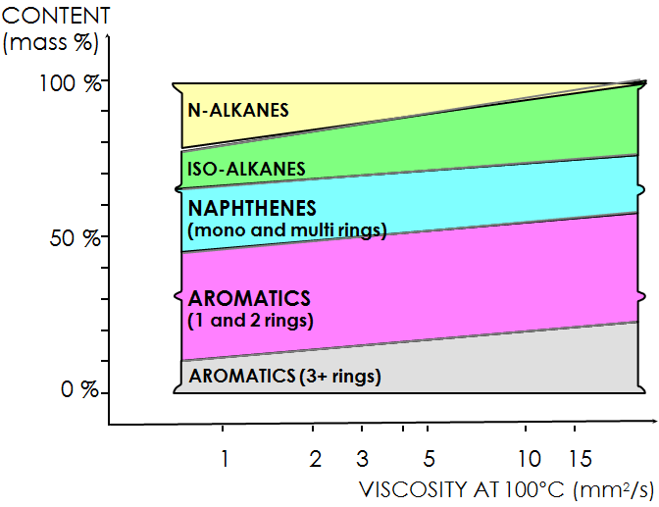
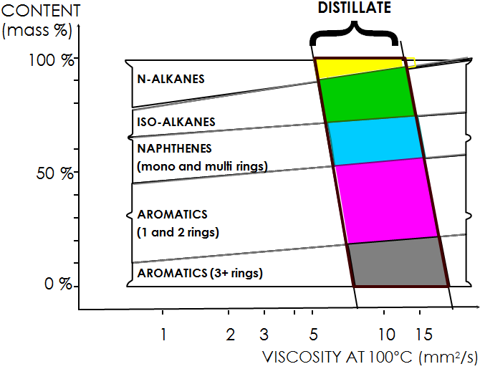
Atmospheric and Vacuum Distillation Impact
Distillation determines the Boiling/Carbon/molecular weight range of the final oil
Boiling range / Carbon # range, Viscosity, Volatility are set by Distillation Units
T2 = 520°C => Number of Carbons = C-40
T1 = 390°C => Number of Carbons = C-24
Typical high viscosity distillate C24 – C40

Slide 14
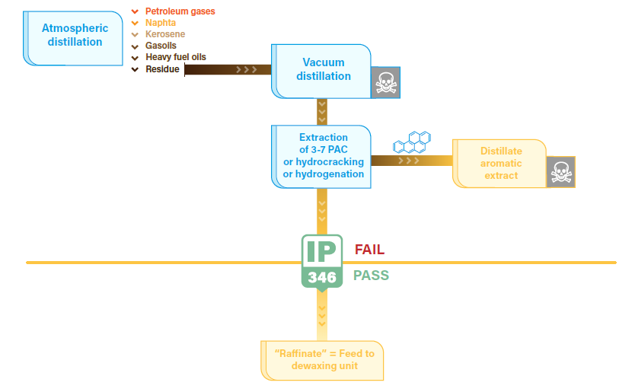
Base Oil, Wax, White Oil Manufacture Step 2: Aromatic Removal

Slide 15
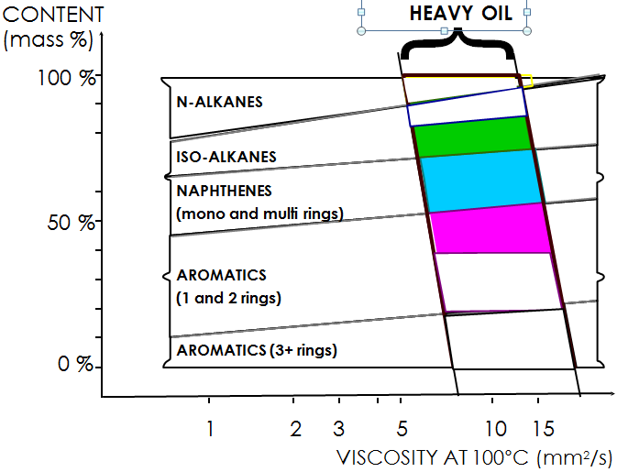
Aromatic Removal Impact (Extraction or Hydrocracking)
Extraction or Hydrocracking or Hydrogenation determines the total aromatics content and removes most of Polycyclic Aromatic Compounds
PARAFFINIC HEAVY
GRADE RAFFINATE
Extraction or Hydrocracking or Hydrogenation determines the total aromatics content
Typical Group I heavy mineral oil
Aromatics:10-40%
Removes most of Polycyclic Aromatic Compounds, down to IP346<3%
Critical step to ensure mineral oils and wax are non-carcinogenic
Notes:
Voice over : Mono or di-aromatic molecules present in mineral oils here boil above 300°C, hence do not include benzene or naphthalene
Solvent extraction unit: it physically separates the aromatic hydrocarbons and minor compounds of higher polarity. A suitable solvent, preferentially extracts the aromatic hydrocarbons and polar components. The solvents used are phenol, liquid sulphur dioxide, furfural, N-methylpyrrolidone or sulfolane, the last three being most commonly used. The solvent is recovered by distillation and recycled. The raffinate obtained contains almost all saturated hydrocarbons from the initial distillate, about 1/3 of the aromatic and polar molecules, and only a few percent of the initial polycyclic aromatic hydrocarbons (PAH).
Hydrokracking: Base oil hydrocracking processes can use different feedstocks, from unrefined or solvent refined distillates, to deasphalted oils or solvent refined deasphalted oils. It also can use slack waxes. The feedstock is heated to the reaction temperature with hydrogen and passed over a series of catalyst beds. The effluent from the reactor passes though a series of separators to remove hydrogen and light hydrocarbons. The effluent product is then fractionated in atmospheric and vacuum distillation towers to provide the desired base-oils and by-products*

Slide 16
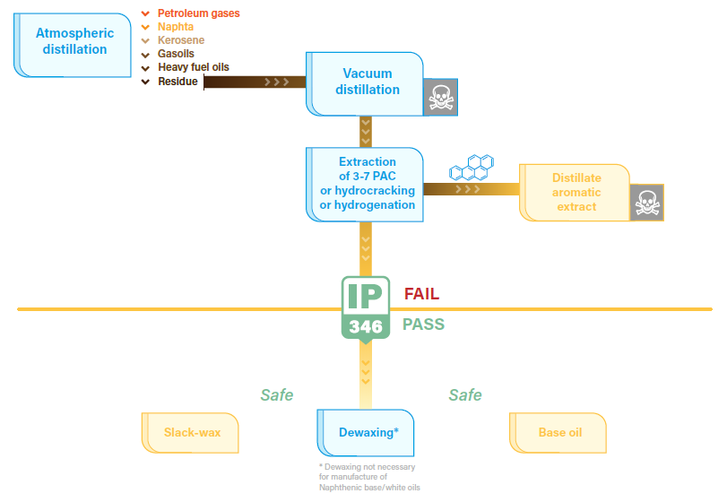
Base Oil, Wax, White Oil Manufacture Step 3: wax separation

Slide 17
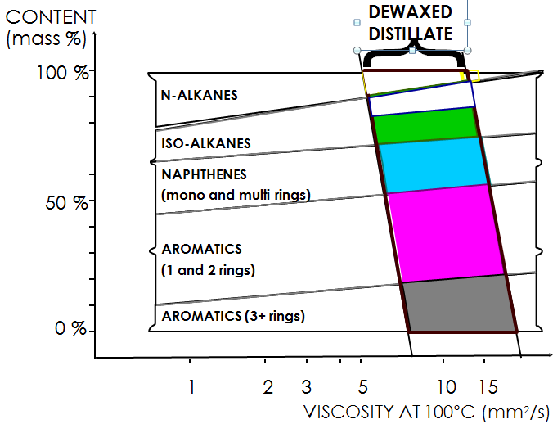
Paraffin separation through Dewaxing
Solvent Dewaxing or Iso-Catalytic dewaxing removes solid waxy hydrocarbons (n-paraffins and some isoparaffins) from mineral oil.
Creates Wax as a co-product.
PARAFFINIC HEAVY
GRADE MINERAL OIL
Typical dewaxed heavy oil
N-alkanes : 0%
Solvent Dewaxing or Catalytic dewaxing removes paraffins and some isoparaffins
⇦
Typical dewaxed heavy oil
N-alkanes : 0%
Notes:
Solvent dewaxing unit: it physically removes the linear alkanes or waxes to obtain a liquid free-flowing and homogeneous at 0 °C. The warm raffinate or hydrocrackate is diluted with an anti-solvent of waxes and the blend progressively cooled. This induces the progressive and selective crystallisation of waxes. The slurry of wax crystals is separated by filtration. The filtrate is distilled to recover and recycle the solvent. Typical solvents used are light ketones, LPG, toluene and blends of these. Oil yield depends on the waxy character of the crude and which pour point is targeted. The impact on composition is an almost complete removal of linear waxes, a reduction of little-branched isoparaffins, balanced by a slight, proportional increase of other hydrocarbon types and polar residues.
Isodewaxing catalytic unit: it physically isomerizes the linear alkanes or waxes to obtain isoparaffins. A catalytic process is used in the sequence of refining processes employing hydrogen at high pressure. This unit is usually fed with hydrocracking residue but also with slack wax can be used. As a result of this process a lower pour point product is produced. A final hydrofinishing process is desirable to produce a high quality base oil

Slide 18
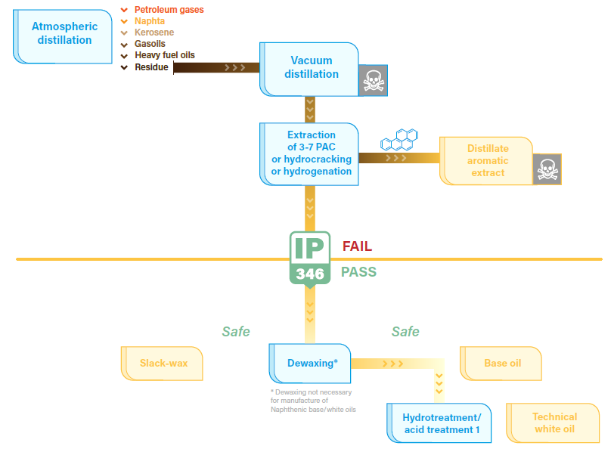
Technical White Oil Manufacture

Slide 19
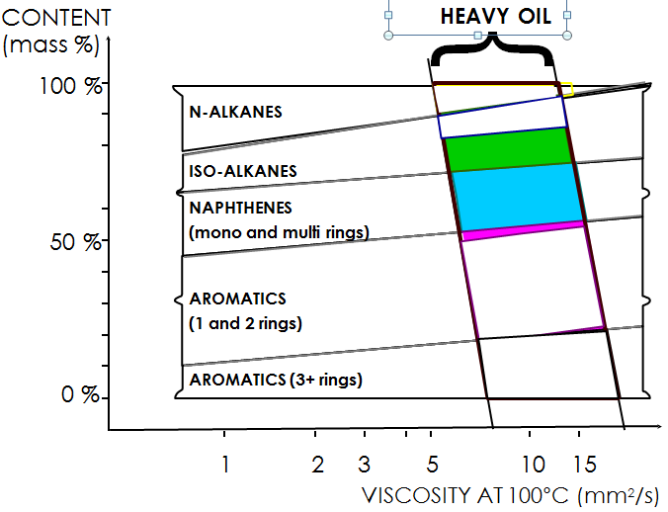
Aromatic saturation through High pressure
Hydrotreatment or Hydrocracking (1st step)
Hydrocracking or Moderate Hydrotreatment or Acid Treatment remove most of aromatics (to a few %), and Polyaromatics below ppm level=>Technical White Oils
HEAVY TECHNICAL
WHITE OIL
Hydrocracking or Moderate Hydrotreatment or Acid Treatment removes most of aromatics (to a few%)
⇦
Typical Heavy Technical
White Oil:
Aromatics%: 0.5-5%
Total Aromatics% typically 0.5-5% level in technical white oils
PAC% below ppm level in technical white oils
Notes:
Message : from a base oil to a technical white oil, there is aromatic content reduction down to a few % range (remaining aromatic % depends on severity of treatment)

Slide 20
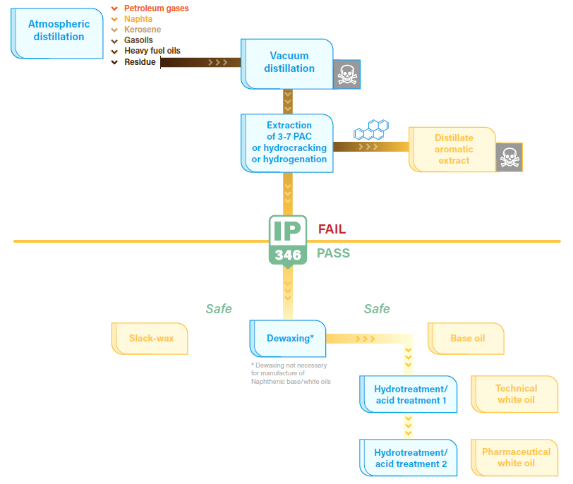
Pharmaceutical White Oil Manufacture

Slide 21
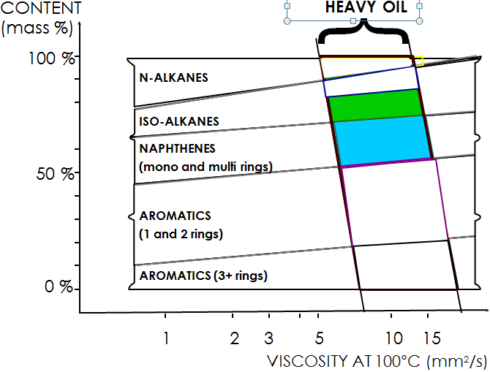
Full Aromatic saturation through
High pressure Hydrogenation (2nd step)
Severe Hydrogenation or Acid Treatment remove nearly all remaining aromatics (to ~0.1%), and bring Polyaromatics to ppb level => Medicinal White Oils
PARAFFINIC HEAVY
MEDICINAL WHITE OIL
Hydrogenation or Severe Acid Treatment = ultimate severity for removal of aromatics
⇦
Typical heavy viscosity white oil
Aromatics %<=0.1%
Total Aromatics typically around 0.1% level in pharmaceutical white oils
PAC% at ppb level or below in pharmaceutical white oils
Notes:
Increase of blue part for aromatics converted to naphthenics

Slide 22
Refining Summary: from crude to pharmaceutical white oil
Refining selects the molecules from the crude oil in a controlled manner to set the final chemical composition (and properties) of the mineral oil
PARAFFINIC HEAVY
MEDICINAL WHITE OIL
HEAVY TECHNICAL
WHITE OIL
Severe Hydrogenation / Acid Treatment removes nearly all aromatics/PCAs
Severe Hydrogenation / Acid Treatment = ultimate severity
⇦
Typical heavy viscosity white oil
Aromatics%<=0.1%
Crude selection determines the initial distribution of paraffinics vs naphthenics vs aromatics hydrocarbons
⇦
Typical paraffinic crude distribution from C15 – C60
Dewaxing or Iso-Catalytic dewaxing removes paraffins and some isoparaffins
⇦
Typical dewaxed heavy distillate
N-alkanes : 0%
Extraction or Hydrocracking or Hydrogenation determines the total aromatics content
⇦
Typical Group I heavy mineral oil
Aromatics%:10-40
Hydrocracking or Moderate Hydrotreatment or Acid Treatment removes most of aromatics (to a few%)
⇦
Typical Heavy Technical
White Oil:
Aromatics%: 1-5%
Distillation determines the molecular weight range of the final oil
⇦
Typical high viscosity distillate C30 – C50
Mineral Oils: Total aromatics range 0-50%, with PAC%<< Aromatic%
Pharma white oils: Total aromatics around 0.1%, PAC below ppb level

Slide 23
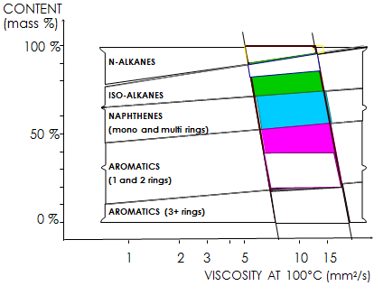
Chemical composition is adjusted
through refining
Removal or conversion of undesirable molecules + Selection of desired molecules is obtained through the various refining units
Final chemical composition adapted to targeted properties and performance
Boiling/Carbon # range, Viscosity, Volatility set by Distillation Units
}
n-Paraffins removal / Wax production in Dewaxing Unit
☺
Full aromatic saturation from severe Hydrotreatment or Acid Treatment (eg White Oil Units)
😐
Poly-Aromatics (+some mono-/di- aromatics) removal in Extraction or Hydrocracking Units
☹

Slide 24
Chemical composition is controlled by specifications
A set of specifications has been developed to efficiently and tightly control mineral oil composition according to its intended application
Volatility or Flash point
Viscosity or GC distillation
}
Pour point or solid paraffin test
😐
CaCpCn by ASTM D2140
or Density or Viscosity Index
☺
😐
Aromatics % in MO by ASTM D2007
Aromatics ppm in WO by direct UV
☹
PACs % in MO by IP 346
PACs ppb in WO by UV DMSO
Specifications defined to ensure Performance in application and absence of Health and Safety concern for end consumers
Specification tests shall be simple and quick to be run on each production batch
Notes:
Reminder : N-Alkanes are not desired in oils / N-Alkanes are desired components in Wax

Slide 25
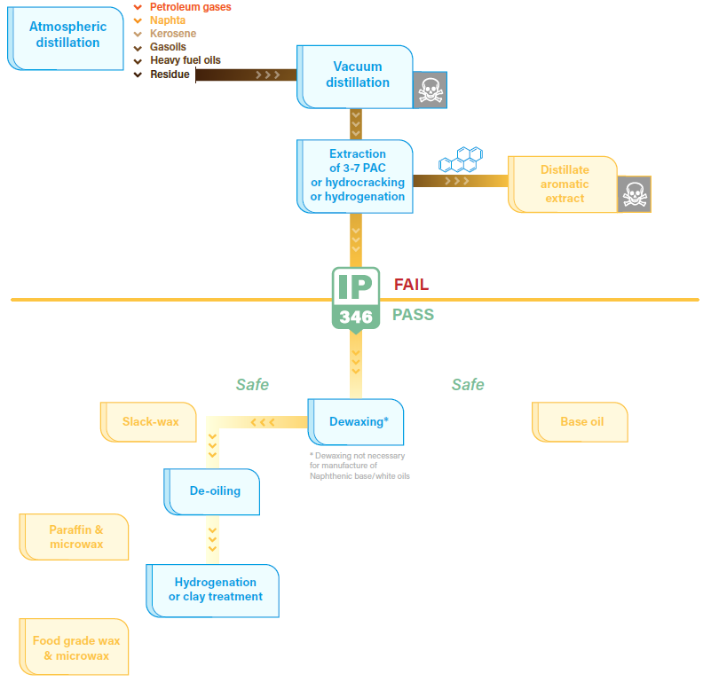
Paraffin and MicroWax Manufacture

Slide 26
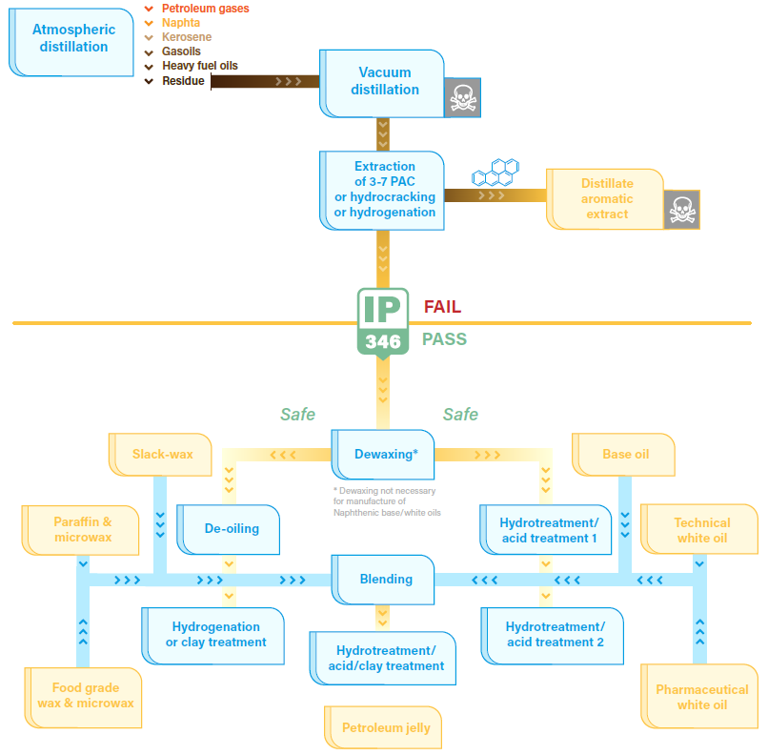
Petroleum Jelly Manufacture

Slide 27
Synthetic Wax and Oil Manufacturing (Fischer Tropsch)
Biomass
BTL/BTS
Coal
CTL/CTS
Natural Gas
GTL/GTS
Process invented in 1925 by Franz Fischer and Hans Tropsch
Uses several carbon sources
Biomass to Liquids/Solids
Coal to Liquids/Solids
Gas to Liquid/Solid
Manufactures a variety of products
Diesel, Naphta, Jet Fuel, Base Oils, Waxes, etc
Commercial product range includes oils of different viscosities and low and high melting waxes
FISCHER-TROPSCH SYNTHESIS
H₂ + CO C_{n}H_{2n+2} + H₂0
Fractionation
SyntheticWax
Synthetic Technical Oil
Hydrogenation
Food Grade Synthetic Wax
Pharmaceutical Synthetic Oil

Slide 28
Questions?
Laurent Jouanneau
Email: laurent.jouanneau@exxonmobil.com

Slide 29
COFFEE BREAK !

Slide 30
Part 2
Mineral Oil and Wax:
Definitions, Uses, Specifications,
Regulations

Slide 31
Technical vs Medicinal White Oils Definitions, Specifications
Definition: “white oils” also defined as Highly Refined Base Oils (HRBO):
Colorless, highly refined mineral oils derived from non-carcinogenic LBO (excludes synthetic oils)
Hydrotreatment or Acid treatment to achieve extremely low levels of aromatics
Technical white oils:
HRBOs not complying with pharmacopeia monograph purity
Meet requirements of US FDA 21 CFR-178.3620(b) – color and UV-DMSO limits
Very low Aromatics, mainly 1-2 ring highly alkylated structures (typically 0.5 to 5%)
Uses: Food Grade Lubricants, rubber extender oils, textile oils, Petroleum Jellies,…
Pharmaceutical/Medicinal/Food Grade white oils (paraffinum liquidum)
Derived from technical white oils, refined in a second step (Hydrotreatment or Acid treatment)
Comply with purity of pharmacopeia monographs (Eur or US) or FDA (US)
Extremely low levels of aromatics (1-2 ring highly alkylated structures) - typically ~0.1%
Purity tests :
UV-DMSO: tracks PACs, used in Pharmacopeias (EU/US) and FDA (US, food-contact)
Direct UV test was used in former DAB (German Pharmacopeia), indicator of «Total aromatics»
Readily Carbonisable Substances: tracks aromatics and impurities
Several categories based on viscosity range in pharmacopeias
Kin viscosity, Mol Weight and Carbon Nber used by JECFA to define mineral oils categories
Also used in EU Plastic Regulation

Slide 32
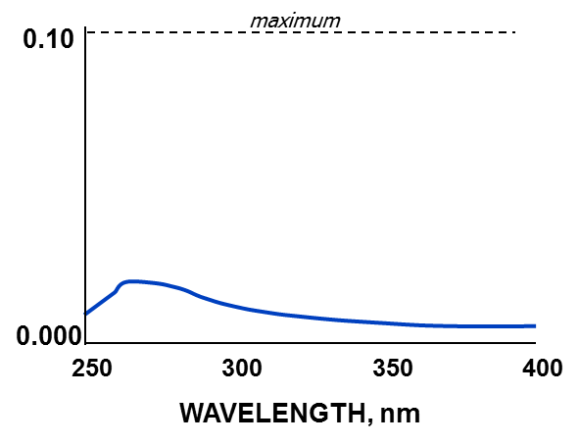
White Oils main purity test: UV-DMSO
Based on UV absorption of DMSO extract of a white oil
WO first diluted with n-hexane
PAHs selectively extracted with DMSO
Absorbance of the extract (260-350 nm range) compared to a reference
described in ASTM D 2269 method
Pharmacopeias Pass limits
max extract absorbance (10 mm cell) ~ 0.10
Estimated equivalent to ~0.3 ppm max of PAHs
Typical PAHs contents in ppb range for most of commercial WOs
required in Pharmacopoeias and FDA specifications
Max absorbance Limit 4.0 for Tech White oils (FDA (b))
Another UV-DMSO test procedure used for FDA(c) oils
simple method, well suited to routine PAH content control of production batches in refinery labs
Io
I

Slide 33
White Oils for Food Applications Regulations and Specifications
Application | Example | EU Regulation | US Regulation
Food Additive | Glazing agent, anti-foaming, carriers, preservative for eggs or dried fruits | EU 1333/2008/EC (Directive 95/2/EEC): White Oils not on positive list¹ | 21 CFR 172.878
Processing Aid | Release agent/lubricant, dedusting agent in grain, pan oil, demoulding oil | No EU Directive Some specific local regulations² | 21 CFR 172.878 (not differentiated from food additives)
Food Contact Materials | Extender oil in plastics, elastomers, paper, glass, metal, wood, cork, textiles, adhesives, pigments … | Framework (EC) 1935/2004 Plastics: EU 10/2011 Others: to be developed Some local regulations³ | Various FDA chapters Require mineral oils that meet 21CFR178.3620 (a),(b) or (c) purity
Lubricant for incidental food contact | Formulation of lubricants for food machinery | No EU regulation | 21 CFR 178.3570 (requires 178.3620(b) oils) NSF H-1 registration
Most existing purity requirements are based on PACs using UV-DMSO methods
(1) Microcrystalline waxes are listed as E 905
(2) Eg French Arrêté for “Auxiliaires technologiques” (Food Processing Aids) – 21 Oct 2006 – demoulding uses (biscuits)
(3) Germany: BfR recommendation XXV Purity requirements for mineral oil (155 BGA Mitteilung), microcristalline wax and paraffin
Notes:
DIRECT FOOD-ADDITIVE
Def. : a non-food substance intentionally added to modify a property of the food (physical, stability, appearance,...)
Europe : (Regulation 1333/2008/EC and Directive 95/2/EEC + subsequent modif.) : White mineral oils NOT on the positive list for a defined list of applications (glazing agent, anti-foaming, carriers, ...)
FDA : 21 CFR 172.878 - Permitted uses are listed , with maximum residual level specified
- release agent/lubricant (tablets/capsules, bakery, dry fruits, vegetables, confectionery, yeast)
- protective coating/float (wine, vinegar, pickles, fruits, vegetables)
- dedusting agent in grain storage, sorbic acid
PROCESSING AID
Def. : a non-food substance intentionally used during the processing, resulting in the presence of non intentional residues in the foodstuff
Europe : Processing aids (e.g.: pan oil, demoulding oil) are not covered in a Directive, so national legislations apply.
e.g. France : use of white oils as processing aid requires it has been permitted in a specific legal text for the specific intended purpose (food / function)
FDA : 21 CFR 172.878 – not distincted from direct food-additives
FOOD-MACHINERY LUBRICANTS:
FDA 21 CFR 178.3570- Lubricants with incidental food contact is the main reference regulation applied by NSF
no legislation at European or national level. Professional bodies refer to NSF (formerly USDA)
EU 10/2011 is the only/main harmonized EU regulations for food contact materials, applicable to oils.
No regulations on direct food additives/release agents, or other Food contact materials. Except for some local regulations at country level, like in Germany :
- Food-contact : German BfR XXI, Leitlinen for Drink water, French Arr. 9 Nov 1994, …
In practice EU 10/2011 requirements often set, even for other materials than plastics ((eg rubbers, elastomers,…)
For Consumer goods for toys, children or for skin contact : Reg. 1907/2006-Annex XVII-entry 50 / Reg. 1272/2013 on PAH limits
In the 1980s a change in the refining process prompted a re-evaluation of the toxicity of mineral hydrocarbons (MHC). In 1995, the Joint Expert Committee on Food Additives (JECFA) of WHO and the EU Scientific Committee on Food (SCF) issued a scientific opinion allocating values for the Acceptable Daily Intake (ADI) of some MHC depending on molecular weight, molecular distribution and viscosity.
In 2001, CONCAWE (European Oil Company Organisation for Environment, Health and Safety) submitted further data on the toxicity of medium and low viscosity oils.
In 2002, JECFA issued a new opinion including the allocation of an ADI at 0-10 mg/kg bw for Class I medium and low viscosity oils in addition to an already existing ADI of 0-20 mg/kg bw for high viscosity oils and high melting point microcrystalline wax. For Class II and III medium and low viscosity oils, the existing ADI of 0-0.01 mg/kg bw was extended (JECFA, 2002).
In 2012, JECFA re-evaluated the temporary ADI for medium and low viscosity Class II and Class III oils. Due to lack of data supporting the establishment of full ADIs, JECFA decided to withdraw the temporary ADI for these mineral oil classes (JECFA, 2012).
Finally, in 2013, EFSA confirmed the JECFA opinion including the temporary ADIs for microcrystalline waxes, high-viscosity mineral oils and Class I medium- and low viscosity mineral oils, renamed medium viscosity mineral oils (EFSA, 2013).
White mineral oils are permitted to be used in plastics for food contact applications according to Regulation 10/2011/EU on plastic materials and articles intended to come into contact with food, when specifications fulfill the criteria set in FCM 95 (PM Ref.: 95883).
Most food contact materials or substances - other than plastics - like paper, elastomers, glass, metal, wood (including cork), textiles, adhesives, pigments are not yet covered by binding EU regulations (Directive, Legislation). Therefore other non- binding EU Resolutions, national standards such as the German BFR Recommendations for food contact materials (plastics, paper, rubbers, etc.) or other relevant industry standards, e.g. guidelines on printing inks, paper etc. may be considered.
• USA
The regulations of the American Food and Drug Administration FDA 21 CFR §178.3620 concerning the purity criteria a), b) or c) apply for uses in the range of indirect food contact. The intended uses as additive for food packaging or production aid agent for food manufacturing are assigned through cross-reference to further paragraphs.
Lubricants with incidental food contact are subject to the paragraph FDA 21 CFR §178.3570. "Mineral oil" is listed with a maximal concentration of 10 ppm in foods.
The approval according to FDA 21 CFR §172.878 for direct food contact is given if the white oil is used as additive, as e.g. preservative for eggs (max. 0,1 %) and dried fruits (max. 0,02 %), anti-dusting agent for wheat, maize and other cereals (max. 0,02 %), mould releasing agents (max. 0,3 %) or bakeries (max. 0,15 %), etc.

Slide 34
EU Plastics Regulation 10/2011 – Food Contact
General requirements outlined in Art. 3 of EU framework Regulation (EC) N° 1935/2004 for materials and articles intended to come into contact with foodstuff.
White mineral oils
Viscosity not less than 8,5 mm²/s at 100°C
Carbon number amount <C25, max 5 %
Average molecular weight not less than 480
FCM 95
Microcrystalline wax
FCM 94
Viscosity not less than 11 mm²/s at 100°C
Carbon number amount <C25, max. 5%
Average molecular weight not less than 500
Products permitted for the use in plastics for food contact applications
Paraffin wax*
FCM 93
Viscosity not less than 2.5,mm²/s at 100°C
Carbon number amount <C25, max 40%
Average molecular weight not less than 350
* Restriction: 0.05 mg/kg food
Not to be used for articles in contact with fatty foods

Slide 35
EU Plastics Regulation vs JECFA/EFSA ADI
EFSA and JECFA have set ADIs to various oil categories (food additive use)
EU Plastic regulation specifies oils and waxes that meet EFSA/JECFA categories
No direct regulatory link between EFSA/JECFA ADIs and the Plastic regulation
Some local regulations have set same oil requirements as EU Plastics Regulation, even if for different materials than plastics
e.g. German Draft Ordinance on Printing Inks, Elastomerleitlinie (Leitlinie zur hygienischen Beurteilung von Elastomeren im Kontakt mit Trinkwasser), Swiss Ordinance 817.023.21 April 2010 for food contact
JECFA/EFSA Categories Specifications and ADIs | ADI JECFA | ADI EFSA | Kinematic viscosity at 100°C (cSt) | Average molecular weight | Carbon number at 5% boiling point | EU 10/2011 Plastic Regulation
Microcrystalline wax | 0-20 mg/kg | 0-20 mg/kg | ≥ 11 | ≥ 500 | ≥ 25 | X
Paraffin wax | - | - | ≥ 2.5 | ≥ 350 | Max 40% C<25 | X
Mineral oil (high viscosity) | 0-20 mg/kg | 0-12 mg/kg | > 11 | ≥ 500 | ≥ 28 | X
Mineral oil (medium and low viscosity) Class I | 0-10 mg/kg | 0-12 mg/kg | 8.5-11 | 480-500 | ≥ 25 | X
Class II | - (removed) | - (removed) | 7.0 – 8.5 | 400-480 | ≥ 22
Class III | - (removed) | - (removed) | 3.0 – 7.0 | 300-400 | ≥ 17
ADI : Admissible Daily Intake
Notes:
JECFA Mineral oil DEFINITION: A mixture of highly refined paraffinic and naphthenic liquid hydrocarbons with boiling point above 200° (medium viscosity) / above 350°C (high viscosity); obtained from mineral crude oils through
various refining steps (eg. distillation, extraction and crystallisation) and subsequent purification by acid and/or catalytic hydrotreatment; may contain antioxidants approved for food use

Slide 36
Legislative framework – Paraffins and Microwax
(*)- Microcrystalline Monograph in progress for European Regulation

Slide 37
Hydrocarbon Waxes as Food Contact Materials - Regulations
The principle of mutual recognition allows for the legal importation and sale into one Member State of products that are legally marketed in another Member State, even if the products do not comply with the specific regulatory requirements of the country of import.

Slide 38
Hydrocarbon Waxes in the (Food Contact) Plastics Regulation EU 10/2011 : specifications and purity

Slide 39
Legislative framework - Food and Pharma uses White oils and Petroleum Jellies
(*)- Microcrystalline Monograph in progress for European Regulation

Slide 40
White Oils Definitions/Specifications Medicinal and Pharmaceutical Applications
Requirements for Medicinal/Pharmaceutical uses based on Pharmacopeia Monographs
Purity requirements are very similar to those of FDA and JECFA

Slide 41
Purity Criteria for pharmaceutical and cosmetic uses Mineral Oil and Wax
INCI: International Nomenclature of Cosmetic Ingredients
No European Pharmacopeia exists for Microcrystalline wax
However PACs are strictly controlled

Slide 42
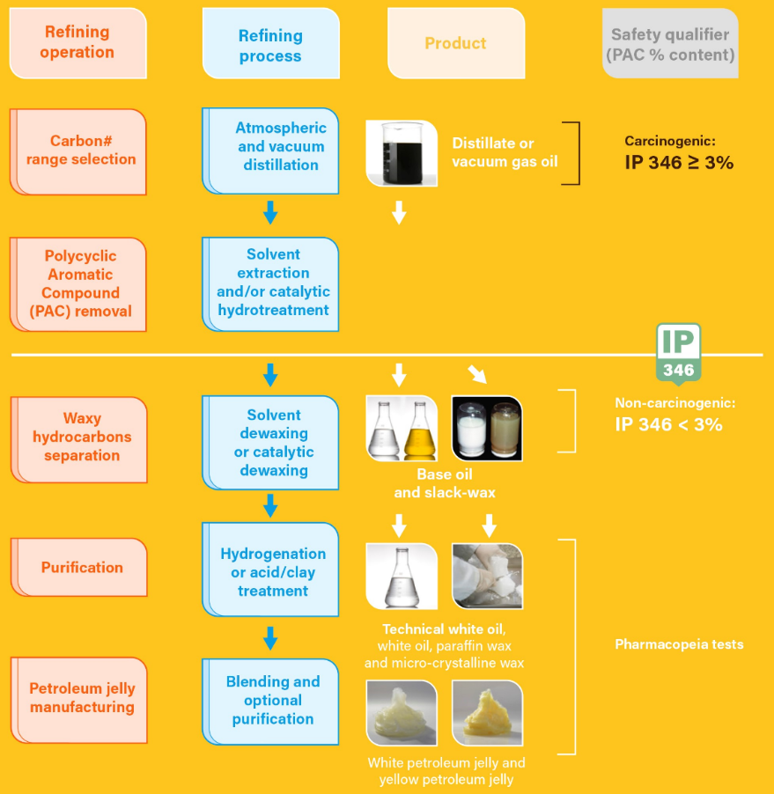
Mineral Oil and Wax - Manufacturing and Quality Assurance Testing

Slide 43
Quality Assurance / Protection from Contamination
Products are controlled vs manufacturing and sales specifications
defined at industry or company level
carefully designed to control their chemical composition
Absence of contamination during refinery transfers, loading and packaging controlled by Quality Assurance procedures
Eg ISO 9001, ISO 14001, Good Manufacturing Practices (GMP)
Notes:
GMP require both an effective Quality Assurance and Quality control system, and associated documentation
- addresses adequate operators training, selection and control of starting material, manufacturing equipement and operating procedures
- quality control system
There are EU Pharma GMP, EU Food Contact GMPs, US FDA GMPs, etc…

Slide 44
Conclusion – Manufacture and composition of Mineral Oil and Wax
Refining selects the molecules from the crude oil in a controlled manner to set the final chemical composition (and properties) of the mineral oil and wax
Removal/conversion of undesirable molecules obtained through various refining units
Product Specifications tightly control mineral oil and wax composition
to ensure performance in application and no safety concern for consumer
tests shall be simple and quick to be run on each production batch
PACs in mineral oil/wax have been removed at desired level
Absence of carcinogenicity controlled by IP346 <3.0% and known refining history
Mineral base oils: Total aromatics can be 0-50%, but PAC% << Aromatic%
Purity of products used in pharmaceutic/cosmetic/Food contact applications ensured by Pharmacopeia UV Tests and adequate Quality Assurance/Quality Control
Medicinal white oils: Total aromatics ~hundreds of ppms, PACs at ppb level
Total aromatics content is not a correct safety indicator
Development of harmonized EU regulations needs to be pursued
compatible EU and US regulations are preferred (e.g. pharmacopeias)

Slide 45
Questions?
Laurent Jouanneau
Email: laurent.jouanneau@exxonmobil.com

